Slide 1
What are the Housing Needs of Our Community?
Planning for Housing in Amador County

Slide 2
Project Team and Timeline
County Point of Contact:
Chuck Beatty, Planning Director
Amador County
(209) 223-6380
CBeatty@amadorgov.org
Consultant Contact:
Beth Thompson, Principal De Novo Planning Group
bthompson@denovoplanning.com
Phase 1
Phase 2
Virtual Workshop
Phase 5
Phase 4
Prepare Draft Housing Element Update
Phase 3
Submit to State for Review and Certification
Evaluate existing conditions
Review existing plans and programs
Housing Needs and Priorities Survey
Stakeholder Outreach
Kick-off
Housing Element Adoption
Public review: 30 days
HCD review: 90 days
Timeline
September 2021 – March 2022
March – April 2022
October 2021 – April 2022
May – August 2022
November – December 2022

Slide 3
Housing Element Basics

Slide 4
What is a Housing Element?
The Housing Element is part of the General Plan and analyzes housing needs and constraints within Amador County and its local cities.
Each local government in California is required to update its Housing Element periodically; each Amador County jurisdiction must update it every eight years
It lays out housing policies and identifies goals and programs that guide housing related actions for each jurisdiction in the County

Slide 5
What is Included in a Housing Element Update?
Housing Element update begins by understanding current conditions
Housing Needs Assessment
Collect data on the housing needs of all residents including:
Seniors
Persons with disabilities, including developmental disabilities
Large families
Farmworkers
Female heads of household with children present
Homeless and at-risk of homelessness
Existing Housing Inventory
Determine the characteristics of the housing stock
How well does existing housing meet the needs of current and future residents?

Slide 6
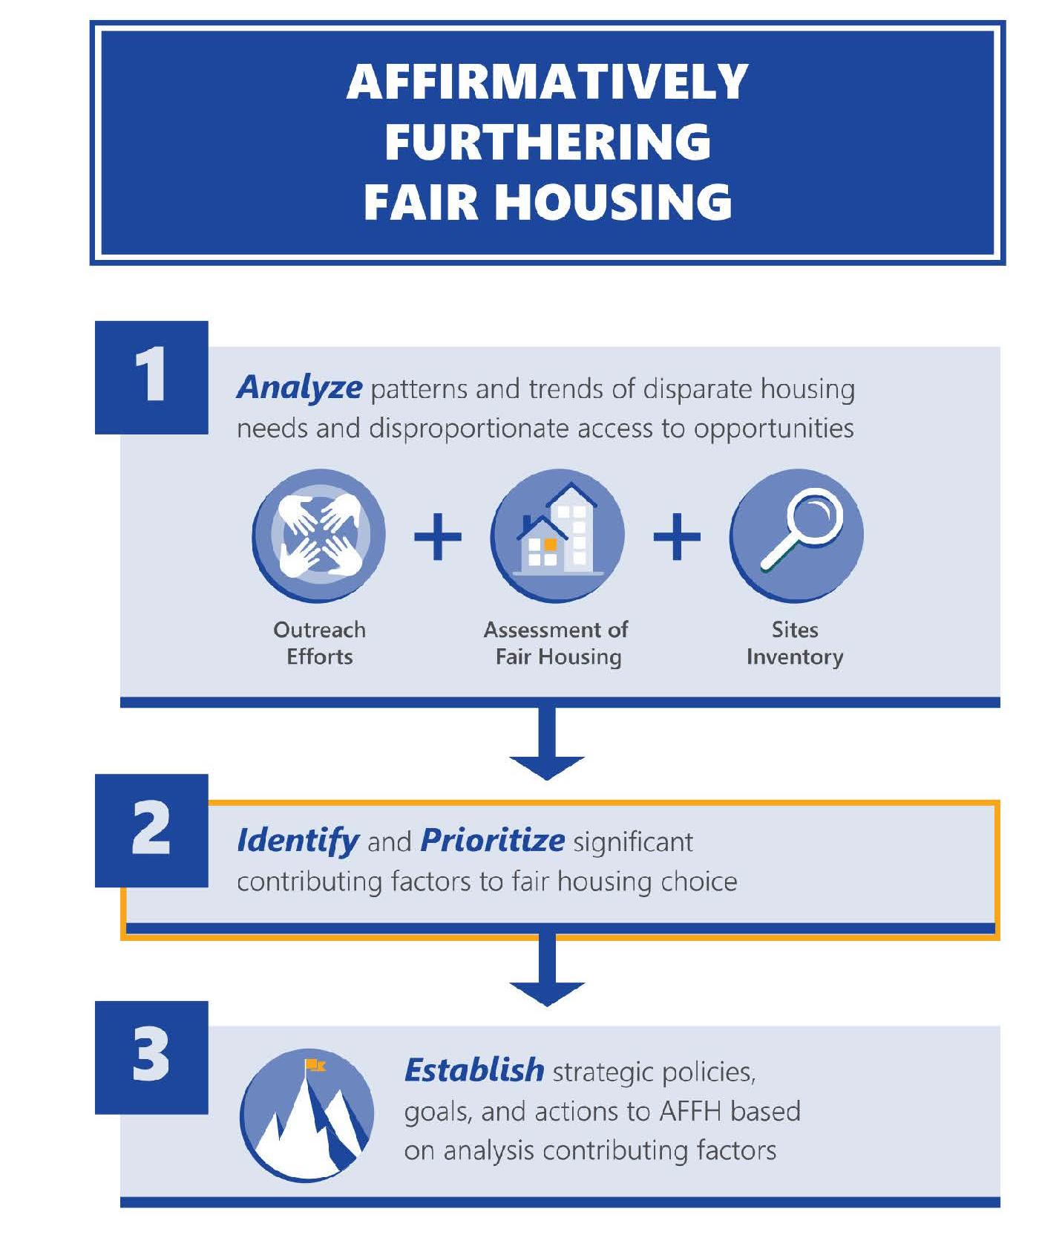
What is Included in a Housing Element Update?
Housing Element update begins by understanding current conditions
Affirmatively Furthering Fair Housing assessment to address patterns of segregation and foster inclusive communities free from barriers that restrict access to opportunity based on protected characteristics.
Analysis must address:
Fair Housing Outreach and Enforcement Capacity
Patterns of Segregation/Integration
Racially and Ethnically Concentrated Areas of Poverty
Disparities in Access to Opportunities
Disproportionate Housing Needs and Displacement

Slide 7
What is Included in a Housing Element Update?
Housing Element will identify constraints to providing housing, such as:
Market constraints, e.g., land and development costs
Zoning regulations
Environmental constraints, e.g., seismic and wildfire hazards
Housing Element will describe the resources available for the development and preservation of housing:
Financial resources, e.g., funding for home rehabilitation
Residential Sites Inventory – Prepare an inventory of vacant and underutilized sites with residential development potential

Slide 8
What is Included in a Housing Element Update?
Housing Element’s goals, policies, and housing programs will address the identified housing needs and constraints
Housing Element must:
Ensure there is adequate land to meet the housing needs
Have programs to facilitate affordable housing development
Mitigate government constraints on housing development
Promote equal access to housing

Slide 9
Planning for Housing in Amador County

Slide 10
Our Role in Regional Housing
The State Department of Housing and Community Development (HCD) assesses and plans for housing growth throughout the State
HCD developed methodology for distributing the regional housing needs of Amador County, based on projected population and housing growth, income levels, vacancy rates, and equity factors, to each city and the unincorporated county through the Regional Housing Needs Allocation, or RHNA, process
The Regional Housing Needs Allocation (RHNA) is the amount of housing each jurisdiction in California must plan for in the upcoming Housing Element cycle

Slide 11
Amador County’s 6th Cycle RHNA
Amador County’s RHNA for the 2023-2031 Planning Period is 741 units
Each jurisdiction must identify enough realistic sites to accommodate its RHNA, but it is not responsible for building the housing itself
Income Level | Affordable Rent/ Purchase Price (4 Person Household) | Income Range (4 Person Household) | Amador County RHNA
Very Low-Income (0-50% AMI) | $663/$97,441 | < $39,350 | 189
Low-Income (50-80% AMI) | $984/$147,176 | $39,350 - $62,950 | 123
Moderate-Income (80-120% AMI) | $1,574/$235,696 | $62,950 - $94,450 | 140
Above Moderate-Income (>120% AMI) | $2,361/$357,893 | $94,450 | 289
Total | n/a | n/a | 741

Slide 12
Amador County’s 6th Cycle RHNA
Income Level | Amador County RHNA | Amador City | Ione | Jackson | Plymouth | Sutter Creek | Unincorporated County
Very Low-Income (0-50% AMI) | 189 | 1 | 30 | 27 | 7 | 15 | 109
Low-Income (50-80% AMI) | 123 | 1 | 20 | 23 | 5 | 12 | 62
Moderate-Income (80-120% AMI) | 140 | 1 | 25 | 24 | 5 | 13 | 72
Above Moderate-Income (>120% AMI) | 289 | 2 | 42 | 64 | 13 | 34 | 134
Total | 741 | 5 | 117 | 138 | 30 | 74 | 377

Slide 13
Inventory of Residential Sites

Slide 14
Housing Element Site Inventory Guidebook
One of the most challenging components of the housing element is the sites inventory.
The County and each City must demonstrate enough land, zoned at suitable densities, to accommodate the allocations.
If the City does not have adequate sites, it must include a program to rezone adequate sites within 1 year of Housing Element adoption.

Slide 15
Site Inventory Guidebook
On June 10, 2020, HCD released the “Housing Element Site Inventory Guidebook” to assist jurisdictions and interested parties with the development of the site inventory for 6th Cycle Housing Elements.
While the specific requirements of sites inventories are detailed in statute and in the HCD Building Blocks website, this guidebook provides a much more technical workflow for jurisdictions and includes how HCD will be interpreting the many changes to State law in the last five years.
The sites inventory is one of the critical components required as a part of housing element updates. It is where local governments must demonstrate suitable land, zoned at suitable densities, to accommodate the RHNA.

Slide 16
Q&A: RHNA and Housing Sites

Slide 17
Community Profile

Slide 18
Local Housing Facts: Population Growth Trends
2021 Population
Amador County: 37,377
Amador City: 153
Ione: 7,712
Jackson: 4,621
Plymouth: 950
Sutter Creek: 2,421
Unincorporated County: 21,520
Source: DOF E-5 ; DOF E-8.

Slide 19
Local Housing Facts: Housing Growth Trends
2021 Households
Amador County: 18,381
Amador City: 110
Ione: 1,816
Jackson: 2,363
Plymouth: 500
Sutter Creek: 1,404
Unincorporated County: 12,188
Source: DOF E-5 ; DOF E-8.

Slide 20
2021 Tenure: Owners and Renters

Slide 21
2021 Housing Stock Composition

Slide 22
Household and Housing Characteristics
 | Amador County | Amador City | Ione | Jackson | Plymouth | Sutter Creek | Unincorporated
Average Household Size | 2.38 | 2.26 | 2.27 | 2.15 | 2.92 | 2.15 | -
Large Households (% of total) | 6.9% | 6.8% | 3.0% | 8.1% | 15.7% | 5.8% | 7.3%
Vacancy Rate | 16.0% | 30.9% | 11.2% | 7.2% | 18.2% | 13.6% | 18.4%
Household Median Income | $62,772 | - | $73,036 | $53,462 | $64,375 | $45,147 | -
Households under Poverty Level | 6.2% | 0.0% | 4.2% | 9.5% | 6.0% | 7.9% | 5.9%
Jobs to Household Ratio | 0.94 | 0.86 | 1.15 | 0.87 | 1.52 | 0.87 | 0.89

Slide 23
Affordability – Ownership (Typical Home Values)
Home prices in Amador County have had a strong upward trend since 2012
In 2022, the median home price in Amador County was approximately $419K
A household needs to make approximately $81K per year ($39hour combined) to afford the typical home price (assuming 20% down)
In 2010, a household only needed to make approximately $47K per year to afford the median home price at that time ($231K)
Source: Zillow, March 2022

Slide 24
Affordability – Rental Rates
The average rental rate in Amador County currently ranges between $920 to $1,965 depending on housing size; these average rents are affordable to households earning approximately $57k to $79k per year.
In 2019:
Renters made up approximately 23.5% (3,429 ) of total occupied housing units; and
Approximately 55.1% (1,717) of renters in Amador County spent 30 percent or more of their monthly household income on housing costs. (source: 2019 ACS 5-Year Estimates DP04)
Source: https://www.bestplaces.net/cost_of_living/city/california

Slide 25
5th Cycle Progress

Slide 26
5^{h} Cycle RHNA Progress
Income Level | Amador City |  | Ione |  | Jackson |  | Plymouth |  | Sutter Creek |  | Unincorporated County
 | RHNA | Permitted | RHNA | Permitted | RHNA | Permitted | RHNA | Permitted | RHNA | Permitted | RHNA | Permitted
Very Low-Income (0-50% AMI) | 1 | 0 | 3 | 0 | 4 | 0 | 1 | 0 | 2 | 0 | 10 | 7
Low-Income (50-80% AMI) | 1 | 0 | 3 | 0 | 3 | 0 | 1 | 0 | 2 | 0 | 7 | 11
Moderate-Income (80-120% AMI) | 0 | 0 | 3 | 125 | 4 | 29 | 1 | 0 | 2 | 20 | 9 | 69
Above Moderate-Income (>120% AMI) | 0 | 0 | 7 | 114 | 8 | 44 | 1 | 46 | 7 | 18 | 23 | 70
Total | 2 | 0 | 16 | 221 | 19 | 73 | 4 | 46 | 10 | 38 | 49 | 157
Jurisdiction | Very Low | Low | Moderate | Above Moderate | Total
Amador | 1 | 1 | 0 | 0 | 2
Ione | 3 | 3 | 3 | 7 | 16
Jackson | 4 | 3 | 4 | 8 | 19
Plymouth | 1 | 1 | 1 | 1 | 4
Sutter Creek | 2 | 2 | 2 | 4 | 10
Unincorporated | 10 | 7 | 9 | 23 | 49
County Total | 21 | 17 | 19 | 43 | 100
Source: HCD 5th Cycle Permits by Jurisdiction (https://app.powerbigov.us/view?r=eyJrIjoiMDA2YjBmNTItYzYwNS00ZDdiLThmMGMtYmFhMzc1YTAzMDM4IiwidCI6IjJiODI4NjQ2LWIwMzctNGZlNy04NDE1LWU5MzVjZDM0Y2Y5NiJ9&pageName=ReportSection3da4504e0949a7b7a0b0, viewed 3/7/2022)

Slide 27
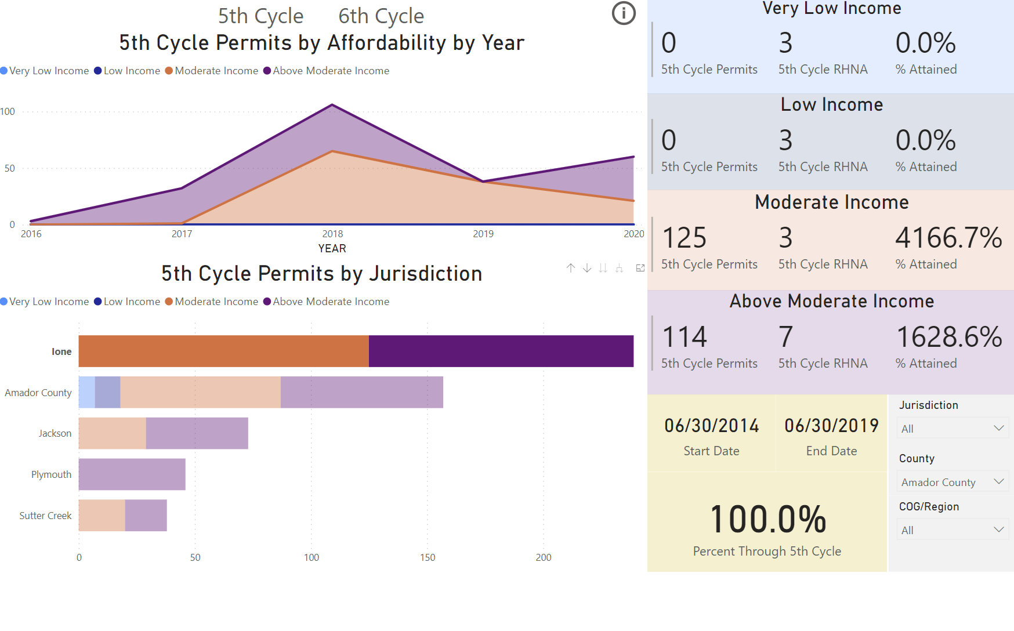

Slide 28
Q&A: Community Overview and 5th Cycle Progress

Slide 29
Activities

Slide 30
Poll Everywhere – Ways to Participate
BY SMART PHONE​ OR COMPUTER Go to pollev.com/beththompson271 ​ on your internet browser.
BY TEXT MESSAGE​ Text beththompson271 to 22-333 on your mobile device.

Slide 31
Notes:
Poll Title: Do not modify the notes in this section to avoid tampering with the Poll Everywhere activity. More info at polleverywhere.com/support Do you live in Amador County? https://www.polleverywhere.com/multiple_choice_polls/TSTIiUx3eZUHdLKVg9TUT

Slide 32
Notes:
Poll Title: Do not modify the notes in this section to avoid tampering with the Poll Everywhere activity. More info at polleverywhere.com/support Do you work in Amador County? https://www.polleverywhere.com/multiple_choice_polls/QBIIakM6zPs2OOPCx5yNT

Slide 33
Notes:
Poll Title: Do not modify the notes in this section to avoid tampering with the Poll Everywhere activity. More info at polleverywhere.com/support In one word or phrase, what opportunities does the County have for this Housing Element? Use a dash to separate words in a phrase. Example: senior-housing https://www.polleverywhere.com/free_text_polls/yNZMqk1pWhXDWUr0FZfhh

Slide 34
Notes:
Poll Title: Do not modify the notes in this section to avoid tampering with the Poll Everywhere activity. More info at polleverywhere.com/support In one word or phrase, what challenges does the County face related to accommodating and maintaining housing opportunities? https://www.polleverywhere.com/free_text_polls/lyTNtAIPc8Po6R3FMGiYr

Slide 35
Notes:
Poll Title: Do not modify the notes in this section to avoid tampering with the Poll Everywhere activity. More info at polleverywhere.com/support What housing types should be prioritized? https://www.polleverywhere.com/multiple_choice_polls/N3PZZiOAr7mZdKPHYpkFc

Slide 36
Notes:
Poll Title: Do not modify the notes in this section to avoid tampering with the Poll Everywhere activity. More info at polleverywhere.com/support What populations have the greatest housing needs? https://www.polleverywhere.com/multiple_choice_polls/yM4NxPorpLxZYRWkCvNFO

Slide 37
Notes:
Poll Title: Do not modify the notes in this section to avoid tampering with the Poll Everywhere activity. More info at polleverywhere.com/support Where in Amador County is housing needed? https://www.polleverywhere.com/free_text_polls/dGDQC9YRRU7JuFo3zmIDA

Slide 38
Notes:
Poll Title: Do not modify the notes in this section to avoid tampering with the Poll Everywhere activity. More info at polleverywhere.com/support What fair housing issues and/or obstacles to housing are you aware of in Amador County and its cities? https://www.polleverywhere.com/free_text_polls/bstVMVTIzRkVwhObuvkqh

Slide 39
Next Steps

Slide 40
Overview of Housing Element Timeline
Housing Element Timeline
Evaluate/Review Existing Conditions, Plans, and Programs from September 2021 to April 2022
Public Review Draft Housing Element in May 2022 (30-day public review)
HCD Draft Housing Element in June 2022 (90-day HCD review)
Adoption Draft Housing Element by October 2022
Final Housing Element Adoption by December 2022
Community and Public Engagement conducted throughout the process

Slide 41
How to Participate and Stay Informed
County Housing Element Update Web Page: https://www.amadorgov.org/departments/planning/2022-housing-element
Housing Needs and Priorities Survey:
https://www.surveymonkey.com/r/AmadorCo_6thHE
If you have any questions, please contact the project lead:
Chuck Beatty,
Amador County Planning Director
CBeatty@amadorgov.org
(209) 223-6380

