Slide 1
OUR MISSION
To Support the Independence and Wellbeing of Older Adults
Through:
Advocacy
Support Services
Education
Activities

Slide 2
Program goals
Nutritional Meals
Dietitian Reviewed
Freshly Prepared
Delivered Daily
Weekend Options
Delivering Smiles by the Miles!

Slide 3
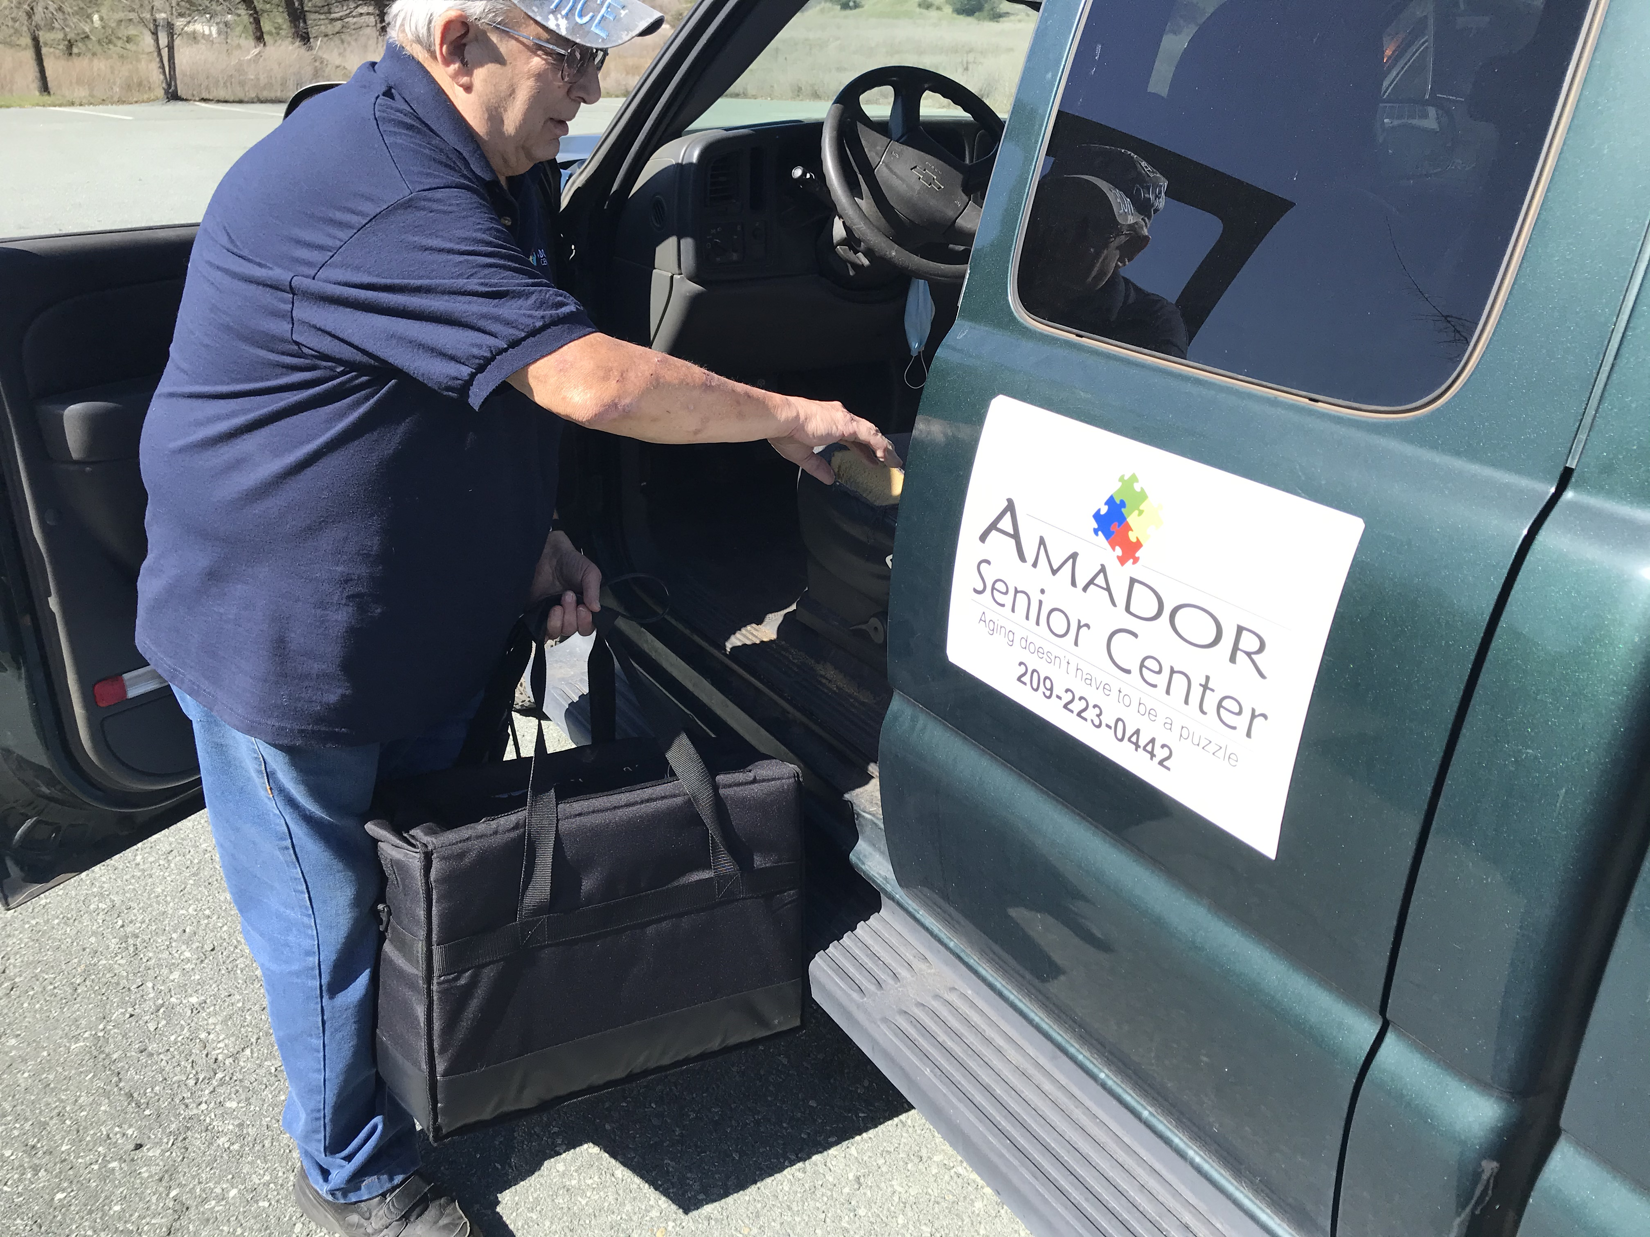
More Than a Meal
Daily Welfare Check
Social Interaction
Improved Mental and Emotional Health
Access to Resources
Every meal delivered is one less demand on county resources

Slide 4
Research project
15-week Study in 2013
Funded by Meals on Wheels and AARP
Conducted by Brown University
Comparing adults 60+ receiving daily meals, weekly frozen meals, and wait list clients.

Slide 5
Results
Those who received daily-delivered meals…
Experienced the greatest improvements in health and quality of life indicators
Reported greater benefits from their home-delivered experience
Improvements in feelings of isolation and loneliness.

Slide 6
Meal Cost
$4.00 - $6.00
Dependent on Income

Slide 7
More Than a Meal
59
New Clients added since July 1, 2021

Slide 8
Clients by Location
(July 1, 2021 – March 31, 2022)
43 – Ione
63 – Jackson
20 – Pine Grove
27 – Sutter Creek
153 Total Clients

Slide 9
Meals by Location
(July 1, 2021 – March 31, 2022)
3,538 – Ione
5,053 – Jackson
1,077 – Pine Grove
2,004 – Sutter Creek
11,672 Total Meals

Slide 10
Volunteers
(July 1, 2021 – March 31, 2022)
921.58 hours
Valued at $13,823.70
($15/hr)

Slide 11
Pet Support
Pet Food and Supplies
Access to Veterinary Services
Grooming
Boarding

Slide 12
What Clients are Saying
I wanted to write you a note and tell you how thankful I am for the service that brings my meals daily. The main course is always so tasteful. I lost my husband in June and I am legally blind. My daughter takes care of me.
- Pat

Slide 13
What Clients are Saying
The lunch service you provide to us is a life saver and my husband and I want to say thank you. We are elderly. My husband has COPD so we have to be very careful with the virus.
- Gail

Slide 14
Amador Senior Center
HOME DELIVERED MEALS PROGRAM

