Slide 1
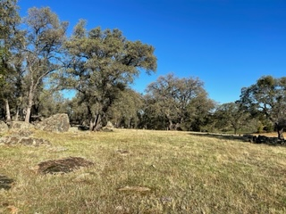

Wicklow Way Specific Plan
CEQA
Scoping Meeting
February 14, 2023

Slide 2
Introductions
Chuck Beatty, AICP - Planning Director
Kimberly Asbury - Project Manager, Montrose Environmental
Kathy Pease, AICP - Planning Consultant, Management Advisory Services

Slide 3

Meeting Format- Hybrid
This Zoom call is being recorded
Presentation slides are available on the project website
Virtual attendees are muted during the presentation:
        If an attendee would like to speak at the end of the presentation, the attendee should raise its hand
        To provide a written comment, please use the Q&A button.
At the end of the presentation, attendees with raised hands will be called upon individually and unmuted so that they can speak.

Slide 4
Meeting Format- Hybrid
Zoom features are located along the black tool bar at the bottom of your screen:
  Chat – This feature is disabled.
  Raise Hand – Click this to indicate that you would like to provide a verbal comment.
  Q&A – Click this to make a written comment.

Slide 5
Meeting Agenda
Meeting purpose and protocol
Specific Plan overview
Overview of the California Environmental Quality Act (CEQA)
Receipt of public comment

Slide 6
Meeting Purpose
CEQA Scoping: To allow the public and agencies to provide input on the scope and content of the project’s environmental impact analysis.
Scoping comments inform the scope and nature of the CEQA environmental analysis.
Notes:
Amador County is the lead agency for preparation of an environmental impact report (EIR) pursuant to the California Environmental Quality Act (CEQA) for creation of the Wicklow Way Specific Plan.
Pursuant to provisions of CEQA, Amador County has prepared a Notice of Preparation (NOP) for the Proposed Project. The purpose of the NOP is to solicit comments from responsible and trustee agencies and interested parties on the scope and content of the environmental information to be included in the EIR.

Slide 7
Meeting Protocol
  Make clear and succinct comments so that we can effectively capture the comment in notes.
  Be respectful of others and differing points of view.

Slide 8
Project Location

Slide 9
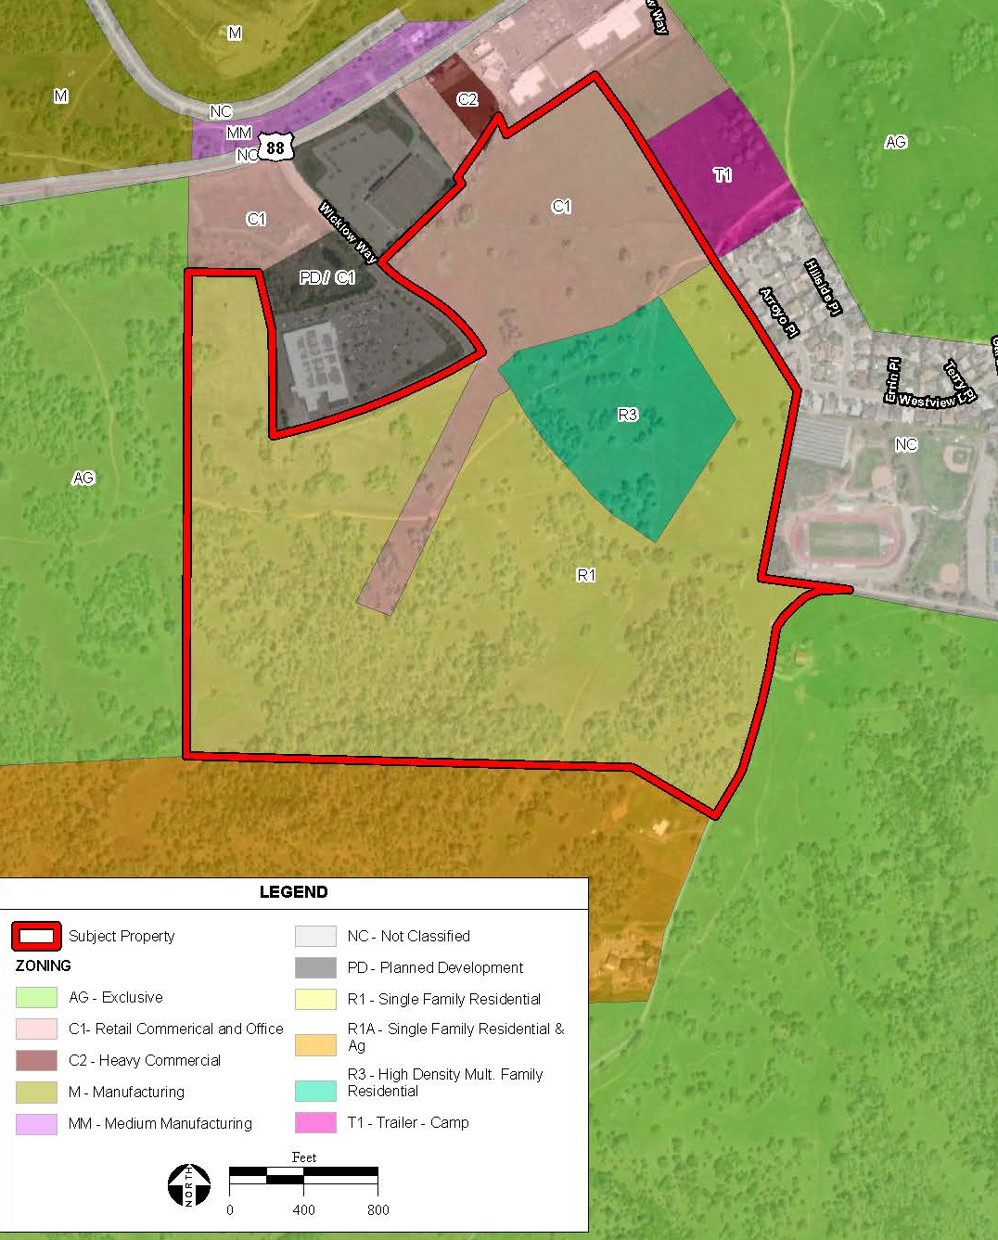
Current Land Use Designations
  Martell Regional Service Center
  Zoned: Residential and Commercial
  Largest potential area for high density housing and commercial uses.

Slide 10
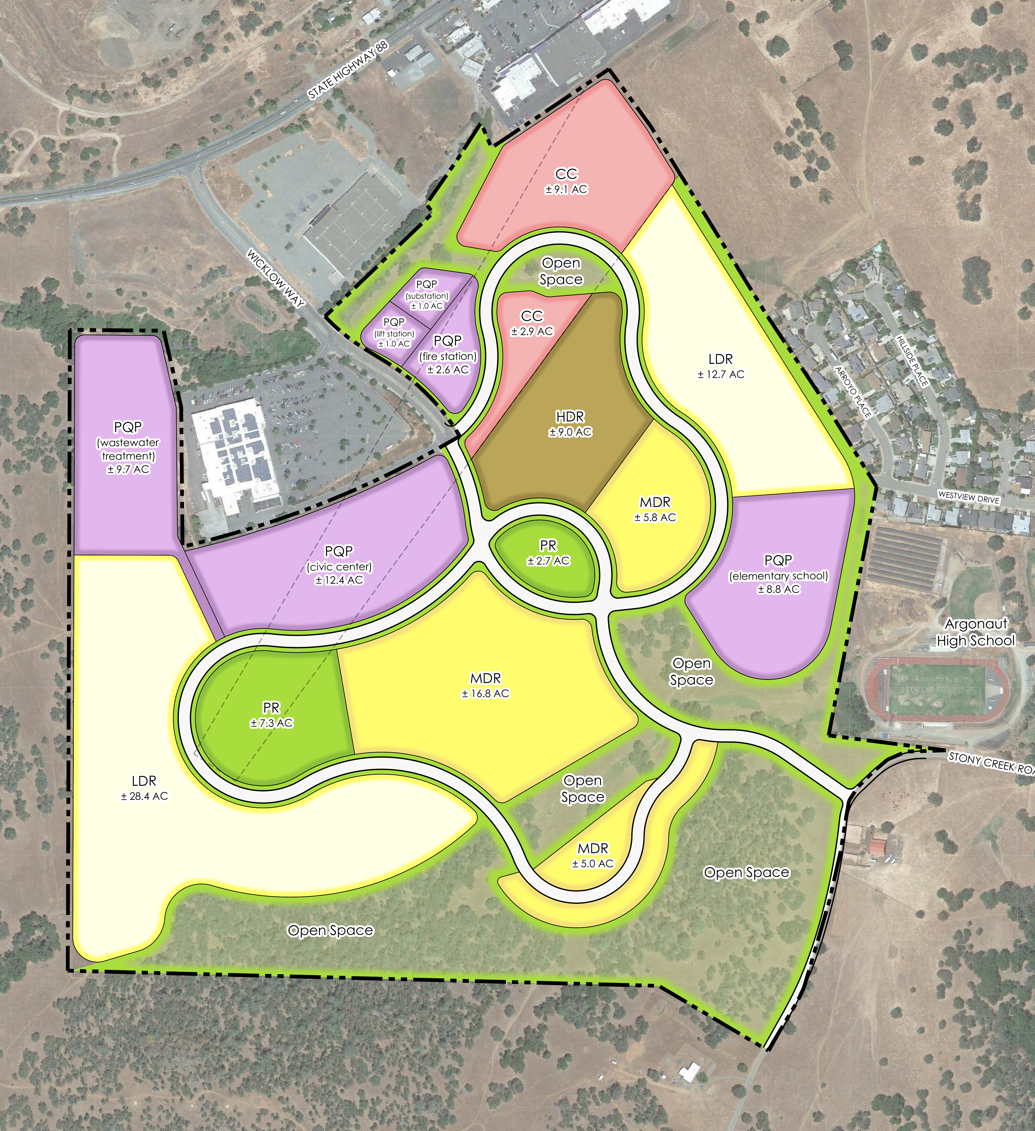
Proposed Land Uses

Slide 11
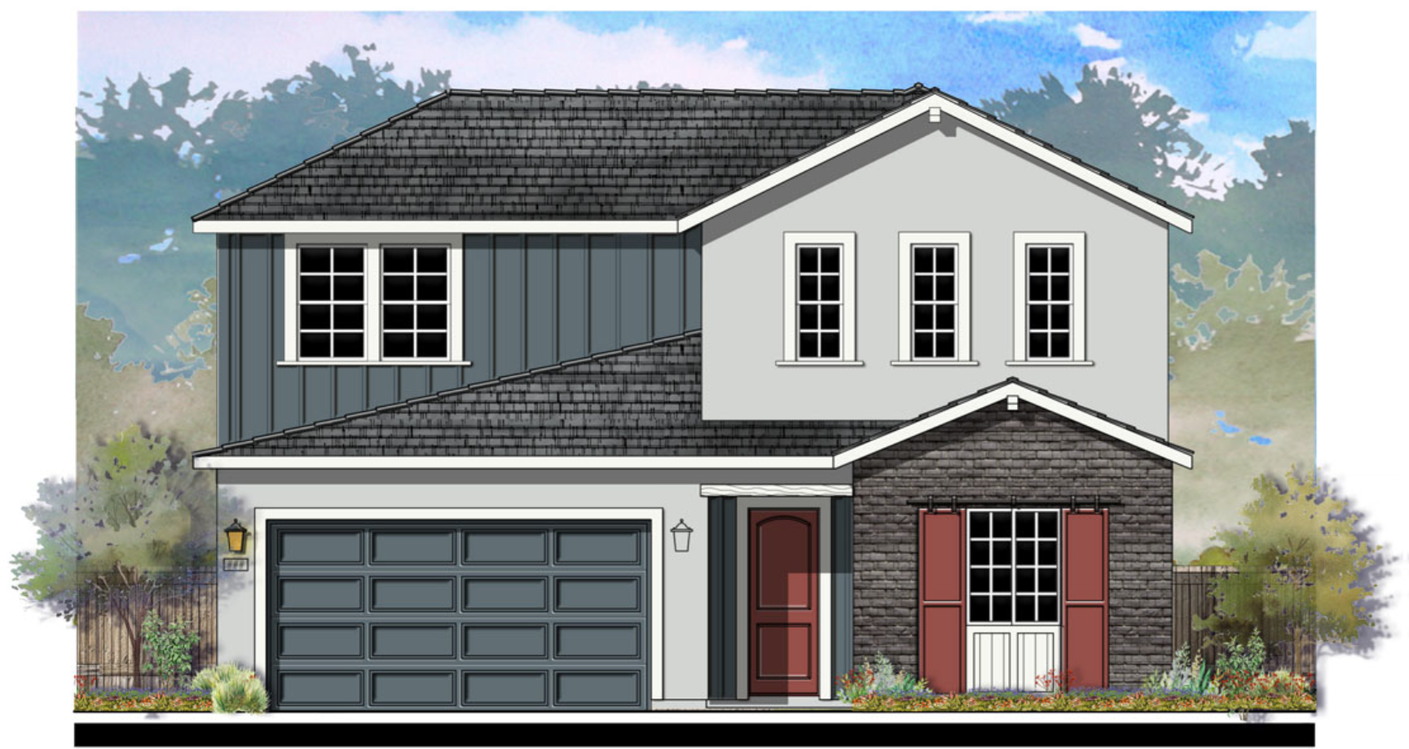
Specific Plan Components
Residential- 700 dwelling units (total)
  Low density – 280 units
  Medium density – 220 units
  High density – 200 units
Commercial – 12.0 acres
Civic Center – 12.4 acres
Open Space – 53.7 acres
Parks and Recreation – 10 acres
Public Utilities and Services – 36 acres
  School, Fire Station, Electric Substation, Wastewater Treatment Plant

Slide 12
SB 2 and Local Early Agency Planning Grants
County received planning grants to help fund community input into developing 200-acre County-owned property;
The grants are intended to facilitate housing development through the specific plan process;
Streamlined approval process requires that the environmental analysis be completed in advance.

Slide 13
CEQA Overview
Basic purposes of CEQA (State CEQA Guidelines, Section 15002(a)):
  Inform governmental decision makers and public about potential, significant environmental effects of proposed activities.
  Identify ways that environmental damage can be avoided or significantly reduced.
  Prevent significant, avoidable damage to environment by requiring changes in projects through the use of alternatives or mitigation measures when governmental agency finds changes to be feasible.
  Disclose to public the reasons why a governmental agency approved the project in the manner the agency chose if significant environmental effects are involved.

Slide 14
EIR Process
45-day
Public Review
Notice of Preparation
February 2023
Draft EIR
Final EIR
Findings, NOD
June 2024
30-day
Public Scoping
Public
Notice
Notes:
Currently we are within the Scoping Review Period. Comments received during the Scoping Period will NOT receive direct responses BUT will be considered during the EIR’s preparation.
The Draft EIR will be prepared and released for public review. This will begin a 45-day public review period. Comments received during the public review period of the Draft EIR will receive responses that will be included in the Final EIR and provided directly to commenting agencies.
At the end of the CEQA process, Amador County will prepare a Findings of Fact and, if necessary, a Statement of Overriding Considerations document to make one or more written findings for each of those significant impacts determined in the EIR, accompanied by a brief explanation of the rationale for each finding, as supported by substantial evidence in the administrative record.

Slide 15
CEQA Resource Topics
Aesthetics
Agricultural resources
Air quality
Biological resources
Cultural resources
Energy
Geology and soils
Greenhouse gas emissions
Hazards and hazardous materials
Hydrology and water quality
Land use and planning
Mineral resources
Noise
Population and housing
Public services
Recreation
Transportation
Tribal cultural resources
Utilities and service systems
Wildfire
Cumulative impacts
Notes:
Required under CEQA

Slide 16
Known Environmental Constraints
Wetland and Drainage Corridors​
Oak Woodland/ Sensitive Habitat​
Airport Land Use Compatibility Zone/ Noise
Sewer Capacity
Water Capacity

Slide 17
Purpose of Scoping
  To provide the public and agencies the opportunity to provide input on the scope and content of the environmental impact analysis.
  Scoping comments can include information on:
    Potential environmental issues
    Potential mitigation measures
    Characteristics of the existing environment
    Resources that may be cumulatively affected
    Potential Alternatives

Slide 18
How to Comment
Submit oral comments tonight.
We encourage the public to submit written comments via mail or email. Send comments to:
    Chuck Beatty, Planning Director
    Amador County
    Planning Department
    810 Court St.
    Jackson, CA 95642
    planning@amadorgov.org
Comments accepted until 5:00 p.m. on
Tuesday, February 28, 2023.

