Slide 2
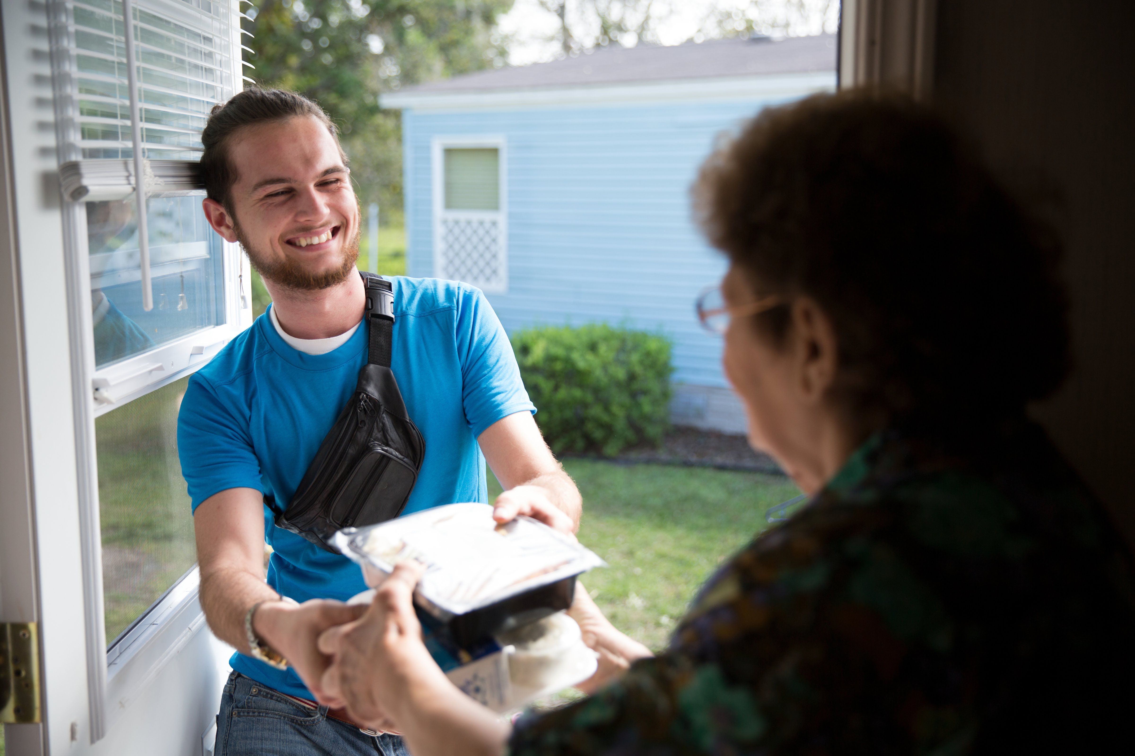
“Delivering Smiles by the Miles”
2023
248 Clients
$1.47 Ave. Client Contribution
32.4% Do Not Contribute

Slide 3
“Delivering Smiles by the Miles”
2022
28,781 meals
2023
36,135 meals

Slide 4
“Delivering Smiles by the Miles”
36,135 meals
County Support
$.83/meal

Slide 5
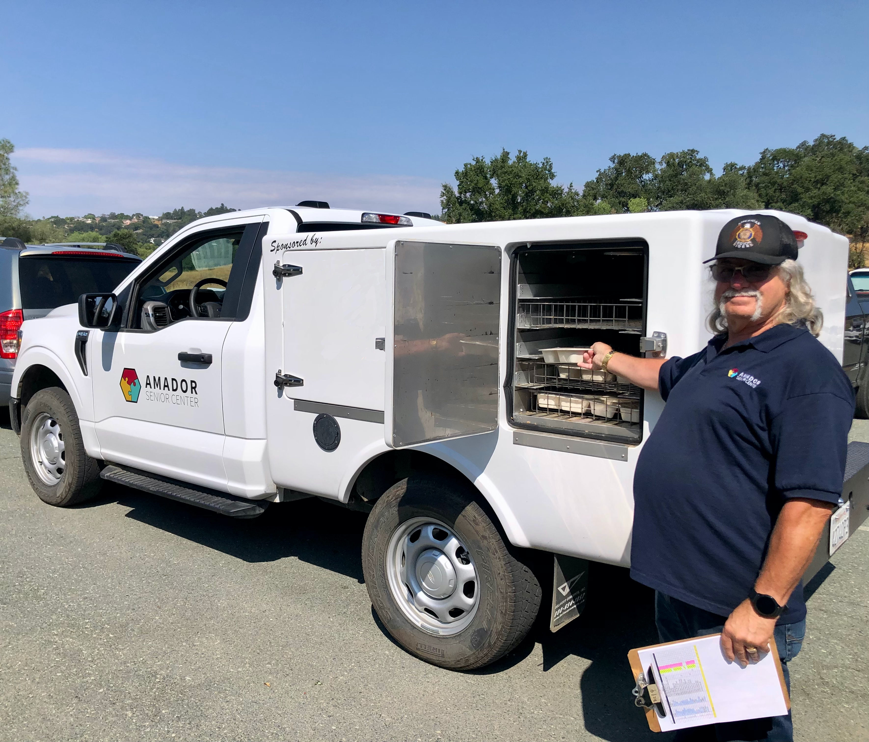
“Delivering Smiles by the Miles”
2023
958.93
Volunteer Hours
$14,863.42

Slide 6
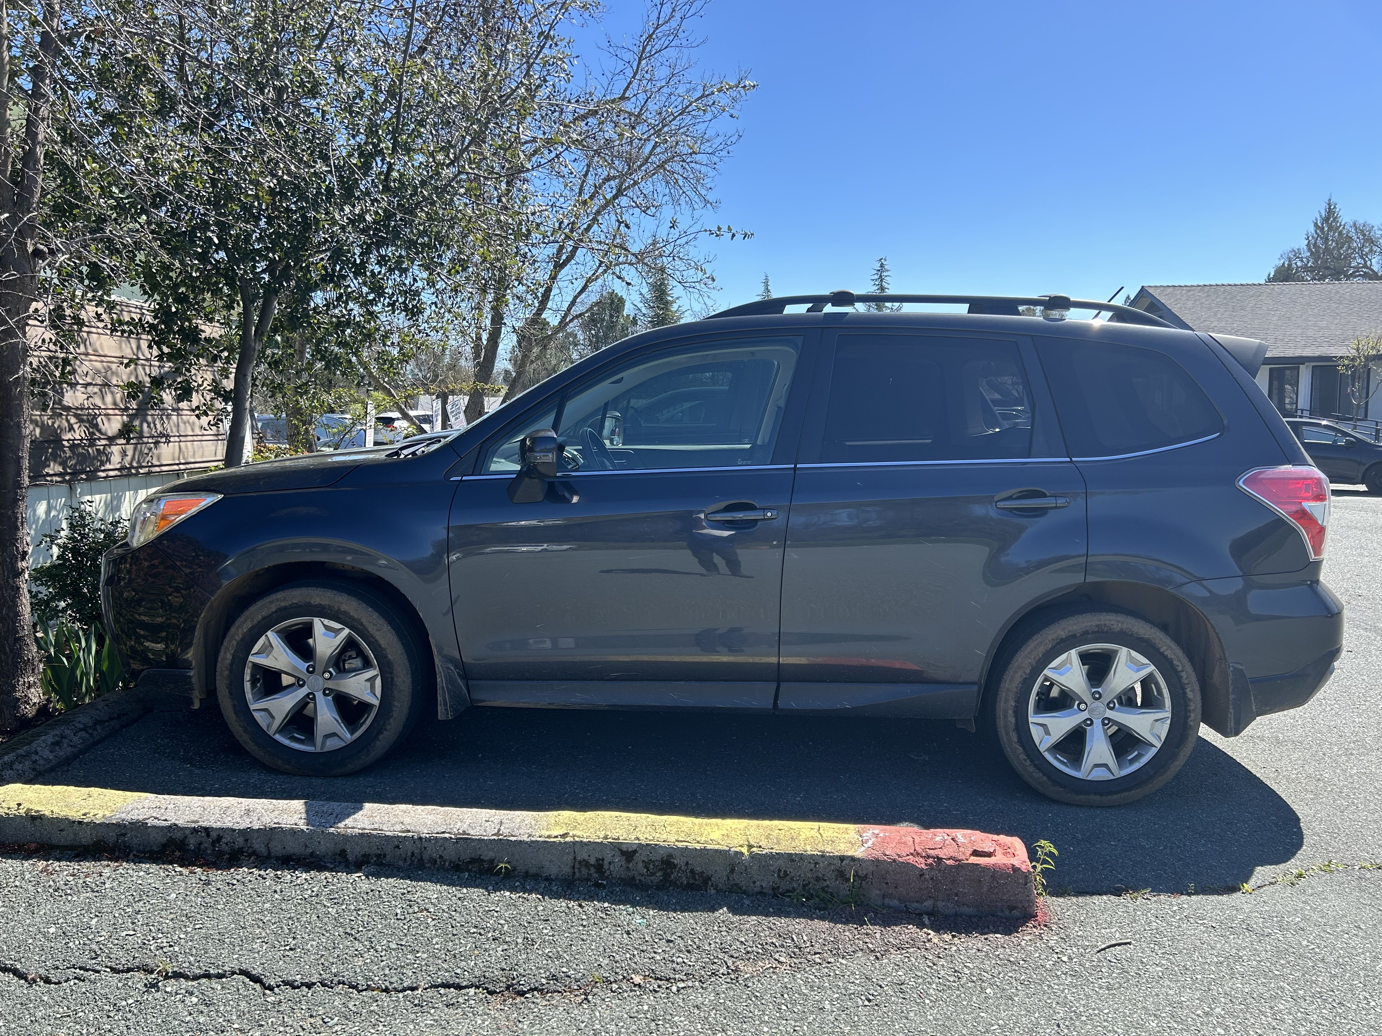
“Delivering Smiles by the Miles”
Increasing Capacity
Additional Subaru

Slide 7
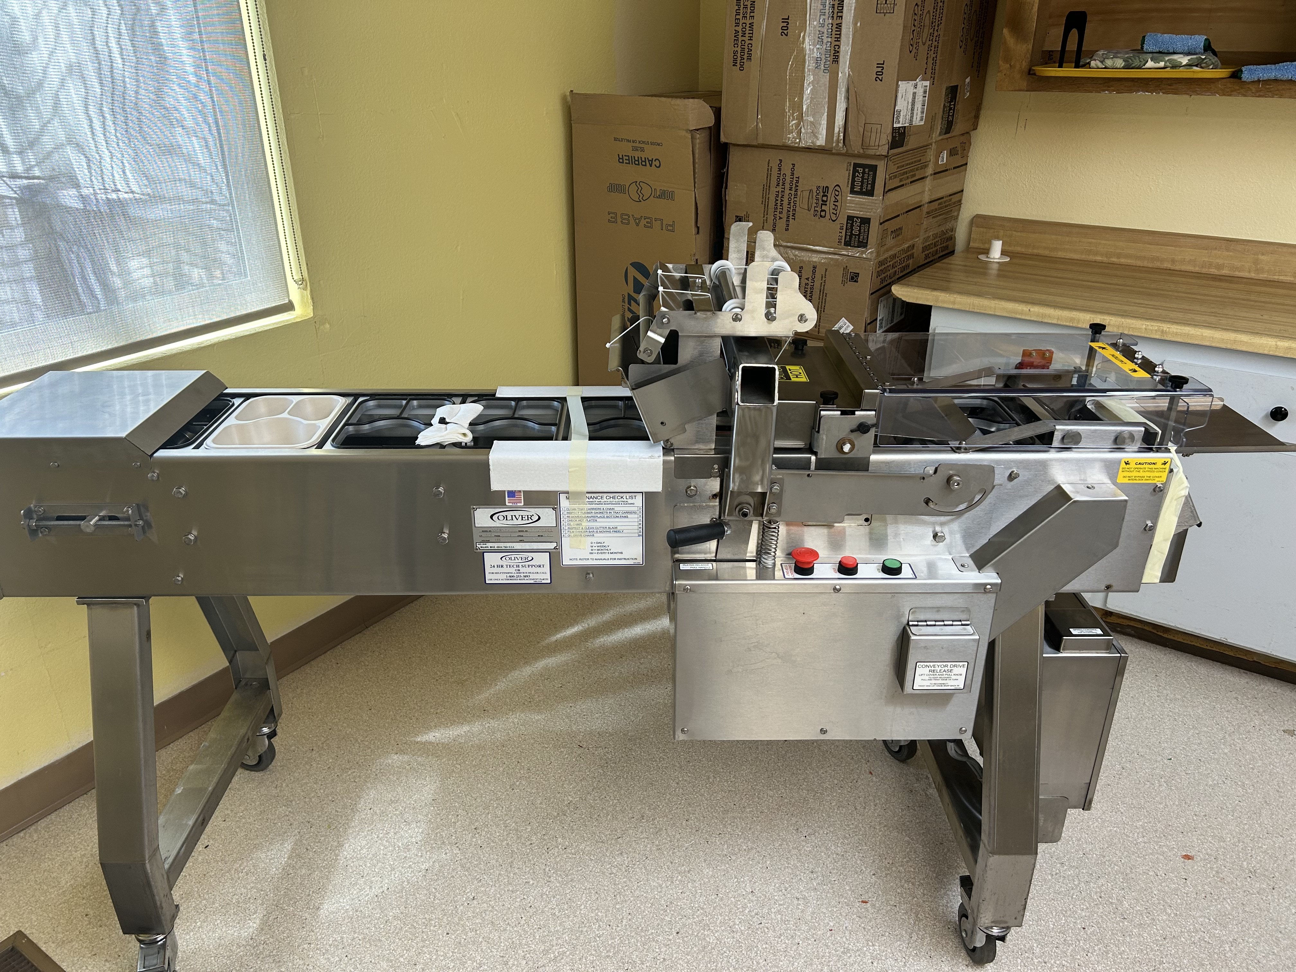
“Delivering Smiles by the Miles”
Increasing Capacity
Auto Packaging Conveyer

