Slide 1



Workers’ Compensation & Liability Market Update
Presenters
Gina Dean, PRISM CEO
Kevin Bibler, Alliant Sr. Vice President
Notes:
PRISM Staff
Thank you for your time
Purpose is to check in and see how things are going, any new needs, go over services
Slides help to provide some structure, but the meeting is meant to be conversational
Also attending the meeting are your Alliant brokers
Alliant is our brokerage partner and has been for many years. They provide a number of different services for the EIA and its mbrs, one of which is being the primary contact for our PE mbrs
I will make this PPT available to download after the meeting

Slide 2

About PRISM
We are a Member-Directed Risk Sharing Pool
  Established in 1979 – Name Change in July 2020 from CSAC EIA
  Joint Powers Authority with primary goal: serve CA public agencies
  Create cost effective/member directed insurance risk pools
  Contain costs & provide in-depth services
  55 of 58 Counties; 311 California Public Entities (approx. 2k organizations); 5 Non-California Participants (approx. 260 organizations)
1.9B
67B
1.56M
94B
140K
Premium
Payroll
Daily Attendance
Total Insured Val.
Employee Lives
Notes:
Largest JPA in the nation
Property – Largest EQ buyer in the world
Large size and economies of scale = more stability, better valued priced insurance market deals, and deals from our service vendors

Slide 3





Risk Sharing
PRISM is not traditional insurance, it is a member-directed risk sharing pool.
Member contributions are pooled for:
Payment of claims
Purchase of reinsurance
Member services
Administration
Investment
Contributions are based on annual budget.
Notes:
PRISM is not traditional insurance. It was formed by its members as a Risk Sharing Pool. It is funded by member contributions which are pooled to pay claims, purchase reinsurance, provide member services, pay for administration and to invest monies for payment of future expenses.
Members benefit from PRISM’s size. The large membership allows for economy of scale when negotiating with reinsurers. Further, the diversification of risk among members – different types and sizes of agencies, and different geographic locations – make the group more appealing to underwriters. Monies coming into PRISM allow for development of members services and risk control programs that would probably not be available to members operating independently.
How much members pay is based on PRISM’s annual budget.

Slide 4




Cost Drivers
Specifics vary by program, but generally:
Exposure base (property values, payroll, etc.)
Actuarial estimates of losses for pool layers
Insurance market
Investment returns
Notes:
There are a few major cost drivers for PRISM’s budget – in other words, there are a few main things that make our budgeted expenses go up or down:
First is exposure base – which is what, and how much of something we are covering. For example, if we cover more employees for workers’ compensation, the exposure base - and associated risk of loss - necessarily goes up.
Next is loss estimates – which is what are our actuaries estimate losses will cost the pool. For example, if the prevailing cost of medical care for workers’ compensation claims is increasing, that will increase costs to the pool and more must be collected from the membership to cover losses.
Next, insurance markets – those determine what kind of reinsurance coverage is available on the open market and how much it will cost PRISM to transfer risk outside the pool.
Finally, we have investment returns – which is how much PRISM’s investments yields can offset costs. The more money we earn on investments, the less money must be collected from members.

Slide 5
Amador County Participation
Founding Member since 1979
Program | Participant Since | County Retention | Limits Provided
Workers’ Comp | 11/1/1979 & 7/1/1997 | $0 | Statutory
General Liability | 4/20/1986 | $10,000 | $25,000,000
Other Pooled Programs:
Property
Medical Malpractice
Health
Dental
Group Purchase Programs:
Airport Liability
Cyber Liability
Crime/Faithful Performance
Pollution Liability
Watercraft Liability
Vision
Life & Disability
Employee Assistance
Notes:
There are a few major cost drivers for PRISM’s budget – in other words, there are a few main things that make our budgeted expenses go up or down:
First is exposure base – which is what, and how much of something we are covering. For example, if we cover more employees for workers’ compensation, the exposure base - and associated risk of loss - necessarily goes up.
Next is loss estimates – which is what are our actuaries estimate losses will cost the pool. For example, if the prevailing cost of medical care for workers’ compensation claims is increasing, that will increase costs to the pool and more must be collected from the membership to cover losses.
Next, insurance markets – those determine what kind of reinsurance coverage is available on the open market and how much it will cost PRISM to transfer risk outside the pool.
Finally, we have investment returns – which is how much PRISM’s investments yields can offset costs. The more money we earn on investments, the less money must be collected from members.

Slide 6
Amador County
Workers’ Compensation
Recent Premium History
19/20 | 20/21 | 21/22 | 22/23 | 23/24 | Est. 24/25
$559,969 | $609,437 | $782,225 | $866,419 | $991,634 | $1,110,000
Premium for 24/25 estimated to increase 12%
Mostly driven by payroll increase of 8%
Recent Claims History
Largest claim was $390k in 2008/09 (trended value would be $851k)
Notes:
There are a few major cost drivers for PRISM’s budget – in other words, there are a few main things that make our budgeted expenses go up or down:
First is exposure base – which is what, and how much of something we are covering. For example, if we cover more employees for workers’ compensation, the exposure base - and associated risk of loss - necessarily goes up.
Next is loss estimates – which is what are our actuaries estimate losses will cost the pool. For example, if the prevailing cost of medical care for workers’ compensation claims is increasing, that will increase costs to the pool and more must be collected from the membership to cover losses.
Next, insurance markets – those determine what kind of reinsurance coverage is available on the open market and how much it will cost PRISM to transfer risk outside the pool.
Finally, we have investment returns – which is how much PRISM’s investments yields can offset costs. The more money we earn on investments, the less money must be collected from members.

Slide 7
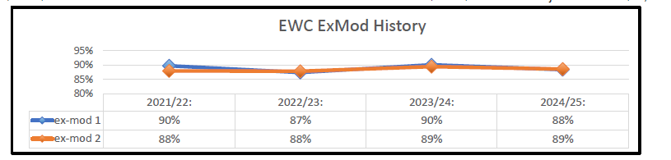
Amador County
Workers’ Compensation
Premiums Based On:
Exposure = measured by Payroll
Experience = measured by losses compared to other members
24/25 Premium Credits:
Favorable ExMod: $41,432
No Large Losses: $7,218

Slide 8
Amador County
Liability
Recent Premium History
19/20 | 20/21 | 21/22 | 22/23 | 23/24 | Est. 24/25
565,978 | 659,268 | 807,096 | 938,400 | 1,318,983 | 1,967,000
Recent Claims History
Largest claim was $4.37M in 2006/07 (trended value would be $15.8M)
Notes:
There are a few major cost drivers for PRISM’s budget – in other words, there are a few main things that make our budgeted expenses go up or down:
First is exposure base – which is what, and how much of something we are covering. For example, if we cover more employees for workers’ compensation, the exposure base - and associated risk of loss - necessarily goes up.
Next is loss estimates – which is what are our actuaries estimate losses will cost the pool. For example, if the prevailing cost of medical care for workers’ compensation claims is increasing, that will increase costs to the pool and more must be collected from the membership to cover losses.
Next, insurance markets – those determine what kind of reinsurance coverage is available on the open market and how much it will cost PRISM to transfer risk outside the pool.
Finally, we have investment returns – which is how much PRISM’s investments yields can offset costs. The more money we earn on investments, the less money must be collected from members.

Slide 9
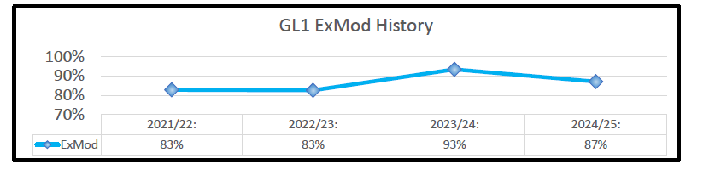
Amador County
Liability
Premiums Based On:
Exposure = measured by Payroll
Experience = measured by losses compared to other members
24/25 Premium Credits:
Favorable ExMod: $69,963
No Large Losses: N/A for 24/25

Slide 10
A Complicated Series of Events
We need to buy insurance from the market too
Pool to $5M
Buy from 9 carriers to provide $25M limit to members
Since 2013/14, claims costs have increased significantly
Claims that used to cost $5M-$10M, now cost $20M-$30M
Trend started in CA, has spread across country
Affects PRISM members too
Upward Trend in Liability Claims
11% Annual Growth for a Decade

Slide 11

Why Are Costs Continuing to Increase?
Nuclear Verdicts
The Court Backlog
Court cases with verdicts above $20mn
Estimated cases as courts reopen and clear backlog aggressively
Source: Verdict Search, Inside P&C

Slide 12
Why Are Costs Continuing to Increase?
Social Inflation

Slide 13
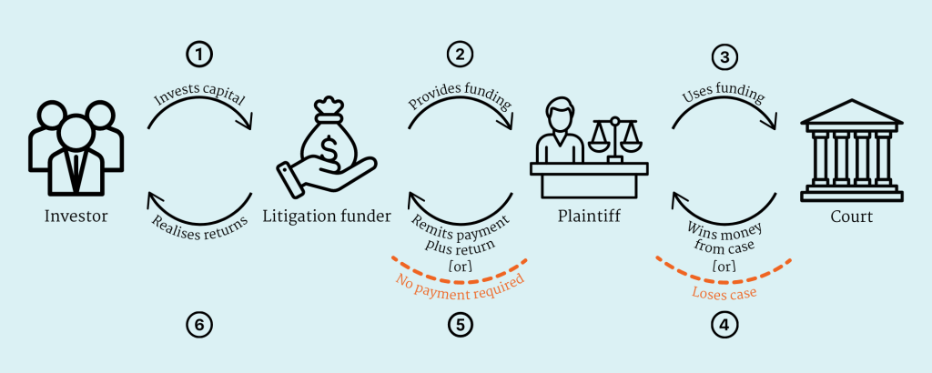
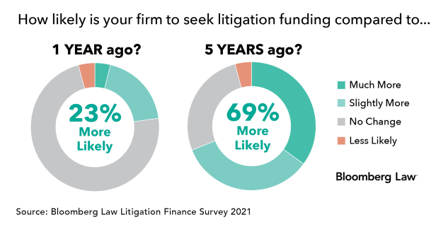
Why Are Costs Continuing to Increase?
Litigation Funding

Slide 14
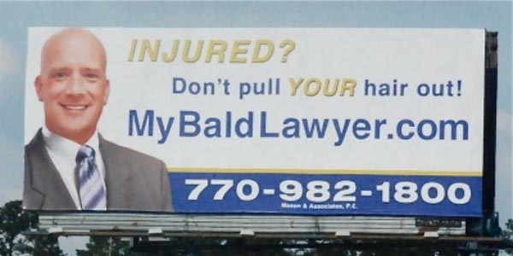
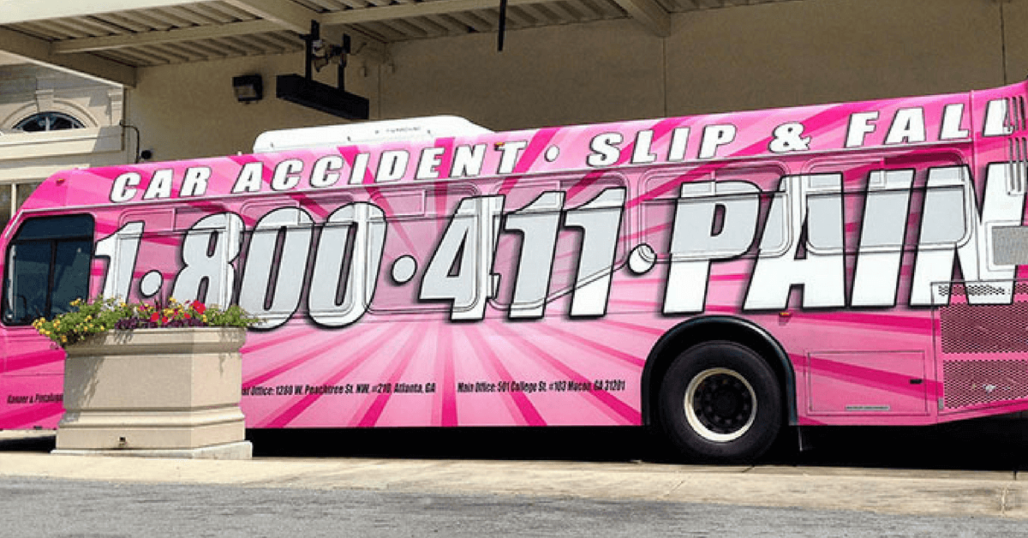


Why Are Costs Continuing to Increase?
Plaintiffs Bar
Over $3.4 billion is spent annually in the United States on legal advertising

Slide 15
Why Are Costs Continuing to Increase?
Jurisdiction

Slide 16




What is PRISM Doing About it?
  Underwriting
  Development of efficient program structures
  Equitable allocations
  Assists with member retention analysis
  Claims
  Assists in setting accurate reserves
  Recommends experts and other experts
  Assist in strategy and advise on settlement negotiations
  Data & Analytics
  On staff actuarial and data analytics expertise, and a Data Scientist
  Predict future costs and establish appropriate funding
  Identify trends, emerging risks and opportunities for loss control
  Loss Control/Member Services
  Tailored trainings and other services to address identified loss trends
  Identify and manage contracts with 3rd party resources for the members
  Manage the Enterprise Risk Consultant program available to the members
Notes:
Largest JPA in the nation
Property – Largest EQ buyer in the world
Large size and economies of scale = more stability, better valued priced insurance market deals, and deals from our service vendors

Slide 17
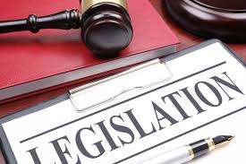



What is PRISM Doing About it?
  Legislative Efforts
  Legislative Committee works with PRISM’s lobbyist to support/oppose bills
  PRISM works with other JPAs to gather/analyze data to support legislation
  Support specific claims through Amicus briefs
  Long Term Carrier Relationships
  PRISM and Alliant work throughout the year to maintain good carrier relationships
  Many have lasted over 25 years
  Incredibly valuable during difficult market conditions or complex claims situations
  Captive Insurance Company
  PRISM developed a Captive Insurance Company
  PRISM Affiliated Risk Captive
  Allows for better investment returns thereby reducing the cost to the members
PRISM | Portfolio | ARC
4.99% | Liquidity | 5.39%
4.28% | Core | 3.94%
N/A | Equity | 7.09%
4.08% | Consolidated | 4.32%
Consolidated Earnings: 4.30%
Notes:
Largest JPA in the nation
Property – Largest EQ buyer in the world
Large size and economies of scale = more stability, better valued priced insurance market deals, and deals from our service vendors

Slide 18
What Can the County Do?
Take advantage of risk prevention and cost control programs offered through PRISM
Stay current on maintenance, inspections and training
Consider assuming more risk
Vigorously defend claims that are defensible
Ensure you can provide high-quality data
Support legislative change that is beneficial to defendants
Consider purchasing additional coverage limits
Help educate the public that the costs of nuclear verdicts are not borne by the insurance industry, but rather by public entities and ultimately the taxpayers

Slide 19
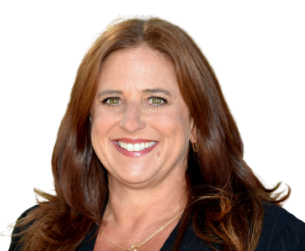
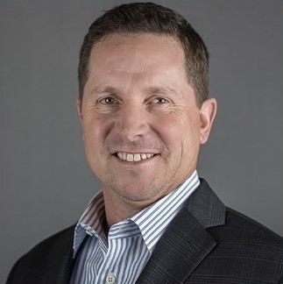
Questions?
We’re here to help!
+ Gina Dean
+ Kevin Bibler
PRISM Chief Executive Officer
Alliant Senior Vice President
916.850.7300
gdean@prismrisk.gov
916.643.2719
kbibler@alliant.com

