Slide 1
2023 GENERAL PLAN
ANNUAL PROGRESS REPORT SUMMARY
AMADOR COUNTY
PLANNING
Required Pursuant to
GOV Code Sec. 65400

Slide 2
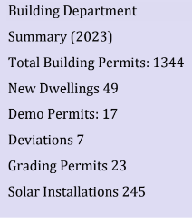
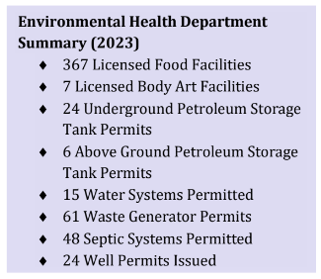
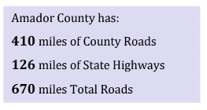
DEPARTMENT STATISTICS
Building Department
Title 15 Building Code
Permits and Type breakdowns
Housing Data
15.30 Fire and Life Safety
Transportation and Public Works Department
County Roads
Traffic Circulation
Surveying Dept
Land Divisions
Recordation of Maps
Environmental Health Department
Special Programs
Wells and Septics ie. Water and Wastewater
AMADOR COUNTY
PLANNING
‹#›

Slide 3
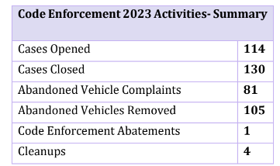
DEPARTMENT STATISTICS
Waste Management
Recycling
Hazardous Waste
Amador Air District
Air Quality (BMPs)
Pollutant Counts
Code Enforcement
Noise
Air Quality Violations | 1
Large Burn Pile Permits | 614
Air Quality Pollutant(s) Sources | 139
*2 Noise Complaints in 2023, one resolved
AMADOR COUNTY
PLANNING
‹#›

Slide 4
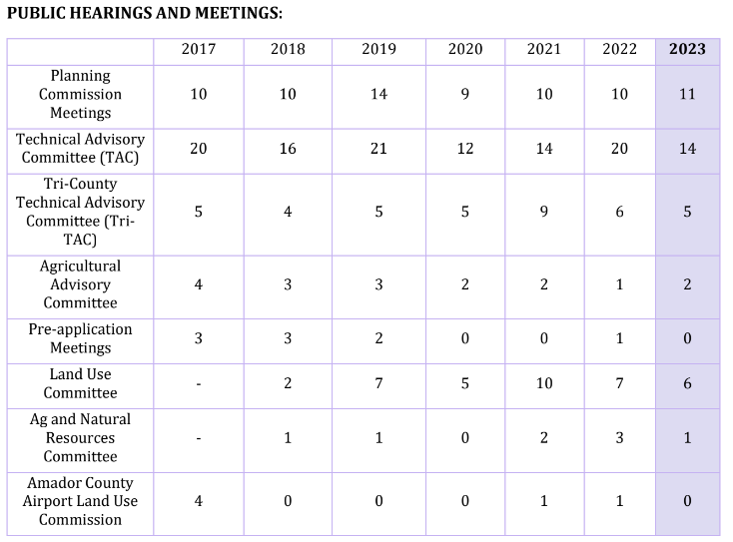
DEPARTMENT STATISTICS
Meetings and Collaboration
Planning
Housing
Use Permits, Zoning, and General Development Trends
General Plan Implementation
Mining
Specific/Master Plans
AMADOR COUNTY
PLANNING
‹#›

Slide 5
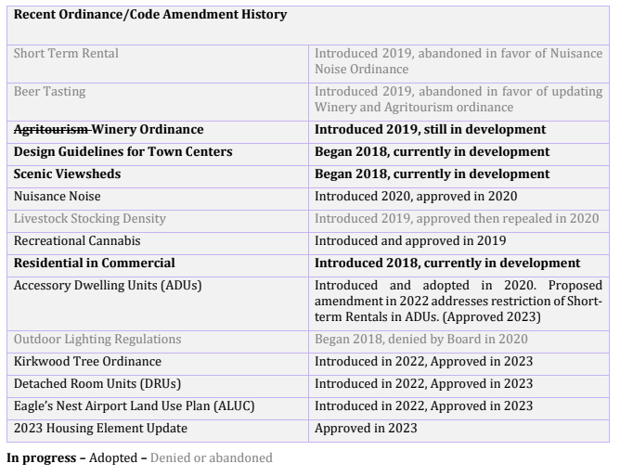
PLANNING PROJECTS
2023 Long-Range Planning Projects:
Agritourism Ordinance
Design Guidelines
Scenic Viewsheds
Residential in Commercial
Kirkwood Tree Ordinance
DRUs
Eagle’s Nest Land Use Plan (ALUC)
2023 Housing Element
Wicklow Way
MLR ADU
AMADOR COUNTY
PLANNING
‹#›

Slide 6
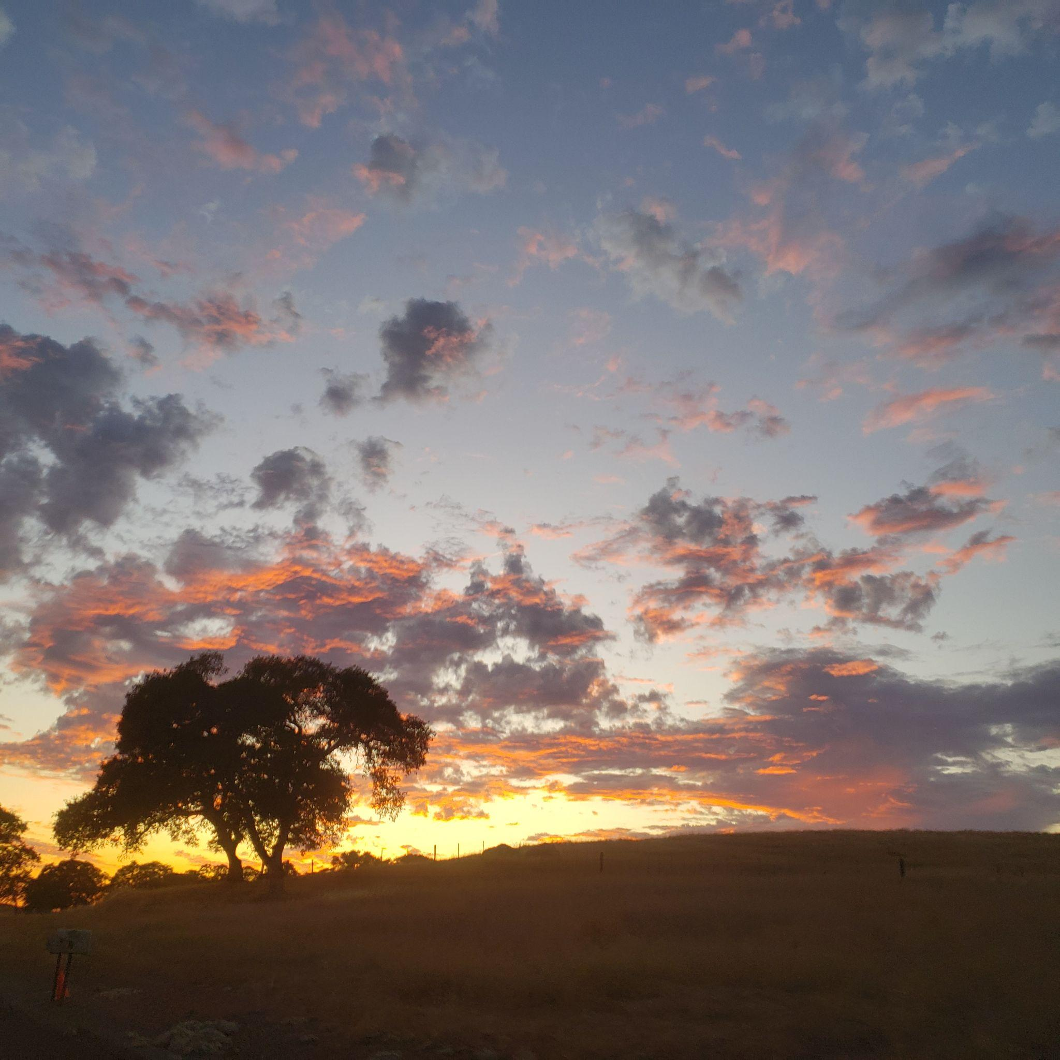
GENERAL PLAN & ZONING CODE UPDATE
General Plan Elements (Cal. Gov. Code. § 65302)
The general plan shall consist of a statement of development policies and shall include a diagram or diagrams and text setting forth objectives, principles, standards, and plan proposals. The plan shall include the following elements:
a. Land Use (CA Timberland Productivity Act of 1982, Military readiness)
b. Circulation (Federal Highway Administration (FHA) Safe System Approach, Alternative Transportation,
c. Housing Element (65580)
d. Conservation (natural resources, reclamation, mitigations, regulation, locations of resources)
e. Open-Space (65560)
f. Noise (roadways, freight, commercial and other aviation, industrial uses, etc.; noise contours)
g. Safety (geology, flooding, fire hazard, local hazard mitigation plan, adaptation strategies, )
h. Environmental Justice
A city, county, or city and county subject to this subdivision shall adopt or review the environmental justice element, or the environmental justice goals, policies, and objectives in other elements, upon the adoption or next revision of two or more elements concurrently on or after January 1, 2018.
—
Governance (optional)
Economics Economic Development (optional)
AMADOR COUNTY
PLANNING
‹#›

Slide 7
Land Use
Goals and Policies
Implementation Plan Measures
Diverse Land Uses
Public Facilities
Community Services
Town Centers
Fire Protection, Emergency Services, and Public Services
Airport Compatibility
Program P-1: | Zoning Code and Development Regulations
Program P-15: | Waste Management
Program P-16: | Lands for Special Uses
Program F-2: | Future Water Supplies and Funding
Program O-5: | Outreach to Property Owners and Developers
Program F-1: | Infrastructure Improvements
Program C-7: | Parks and Recreational Facilities
Program C-8: | Solid Waste Disposal
Program D-1: | Development Proposal Evaluation
AMADOR COUNTY
PLANNING
‹#›

Slide 8
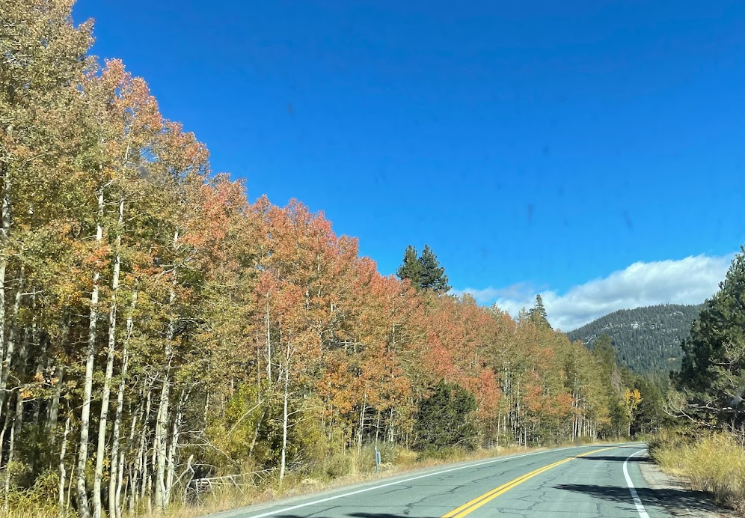
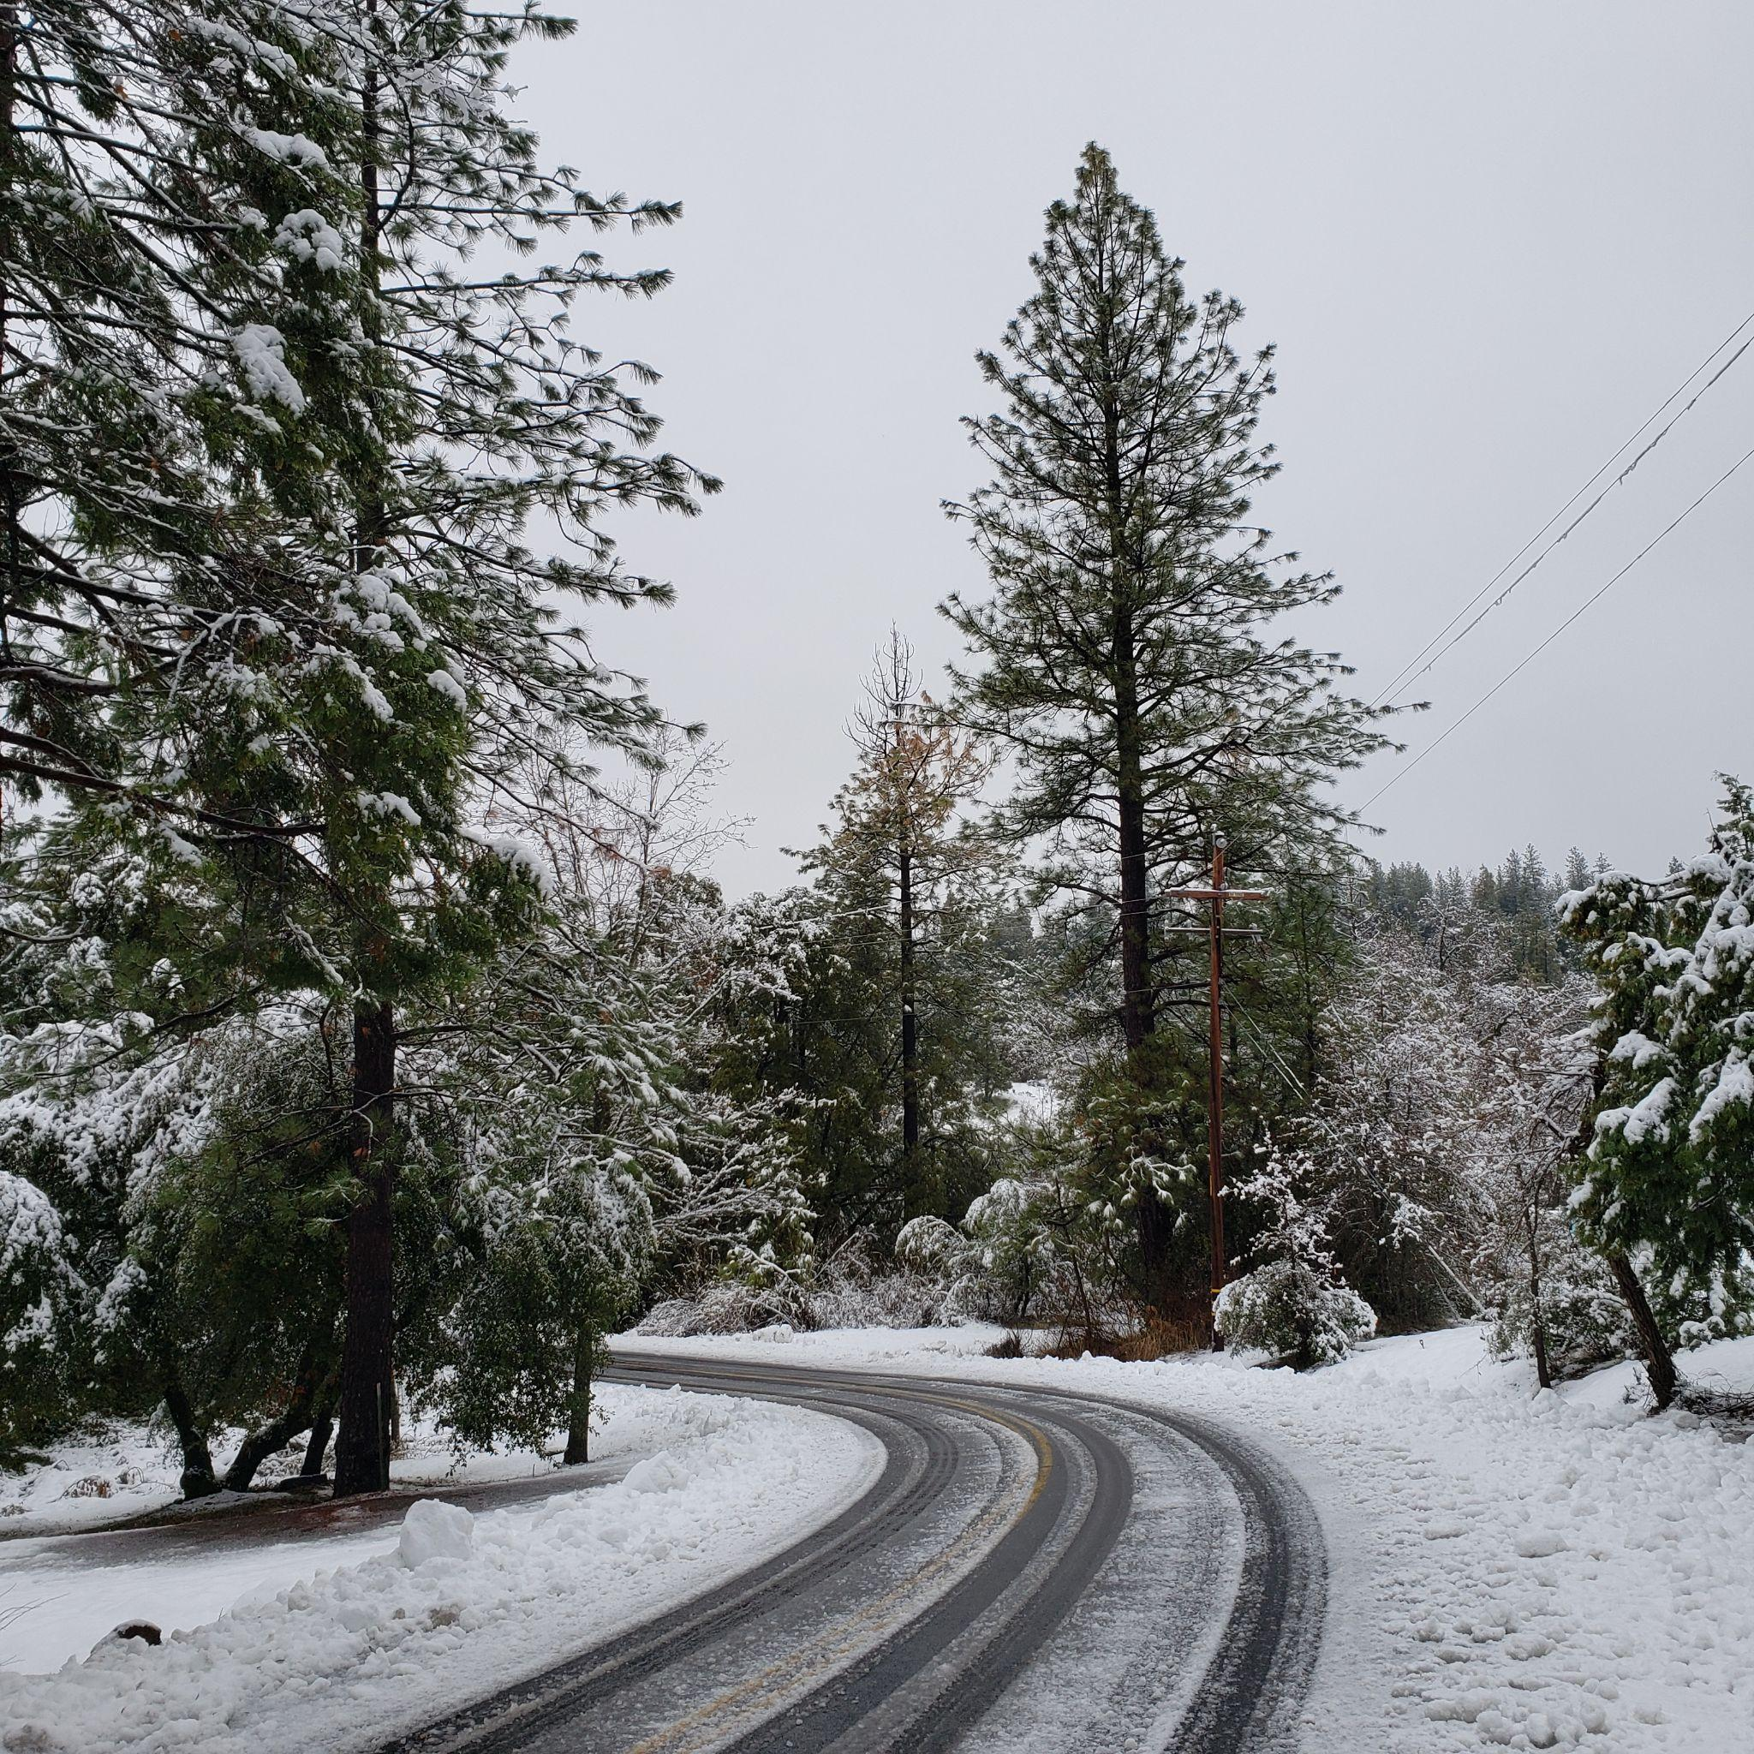
Circulation and Mobility
Goals and Policies
Implementation Plan Measures
Roadway Circulation
Alternative Transportation
Scenic Highways
Program C-3: | Transportation Coordination
Program C-10: | Transit Agency Coordination
Program F-4: | Transportation Improvements
AMADOR COUNTY
PLANNING
‹#›

Slide 9
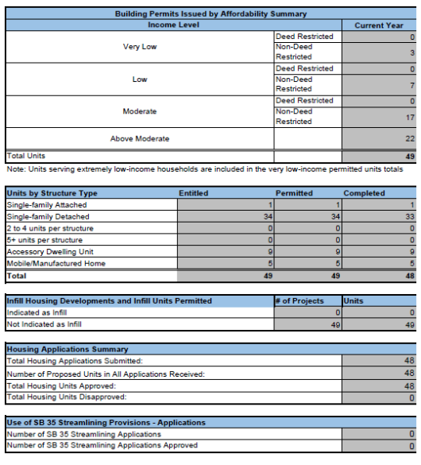
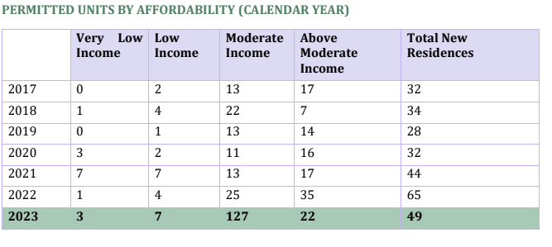
HOUSING STATISTICS 2023
49 NEW DWELLING UNITS in 2023
AMADOR COUNTY
PLANNING
‹#›

Slide 10
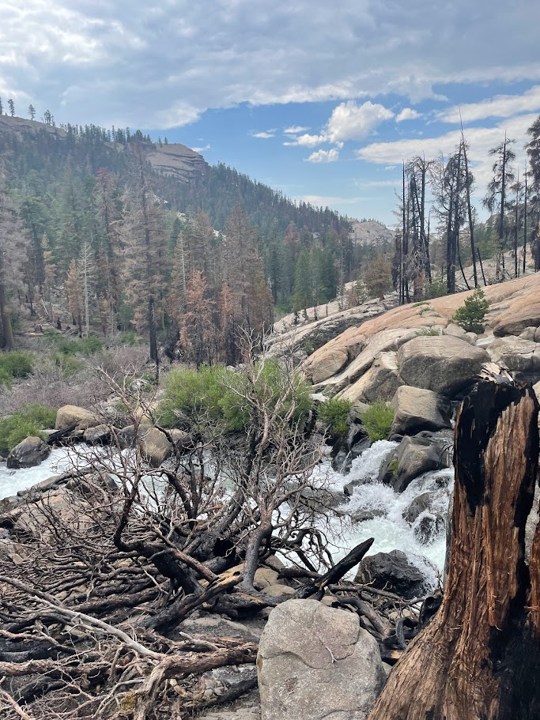
Conservation
Goals and Policies
Implementation Plan Measures
Water Supply and Water Quality
Energy Resources
Historical Resources
Cultural Resources
Air Quality
Greenhouse Gas Emissions
Program P-3: | Future Water Supply
Program P-5: | Stormwater Management
Program D-4: | Biological Resources
Program D-5: | Stormwater Protection
Program D-6: | Historic Preservation, Cultural Resources
Program F-6: | Energy Efficiency, Renewable Energy, and Green Building
Program O-4: | Energy Efficient Businesses
AMADOR COUNTY
PLANNING
‹#›

Slide 11
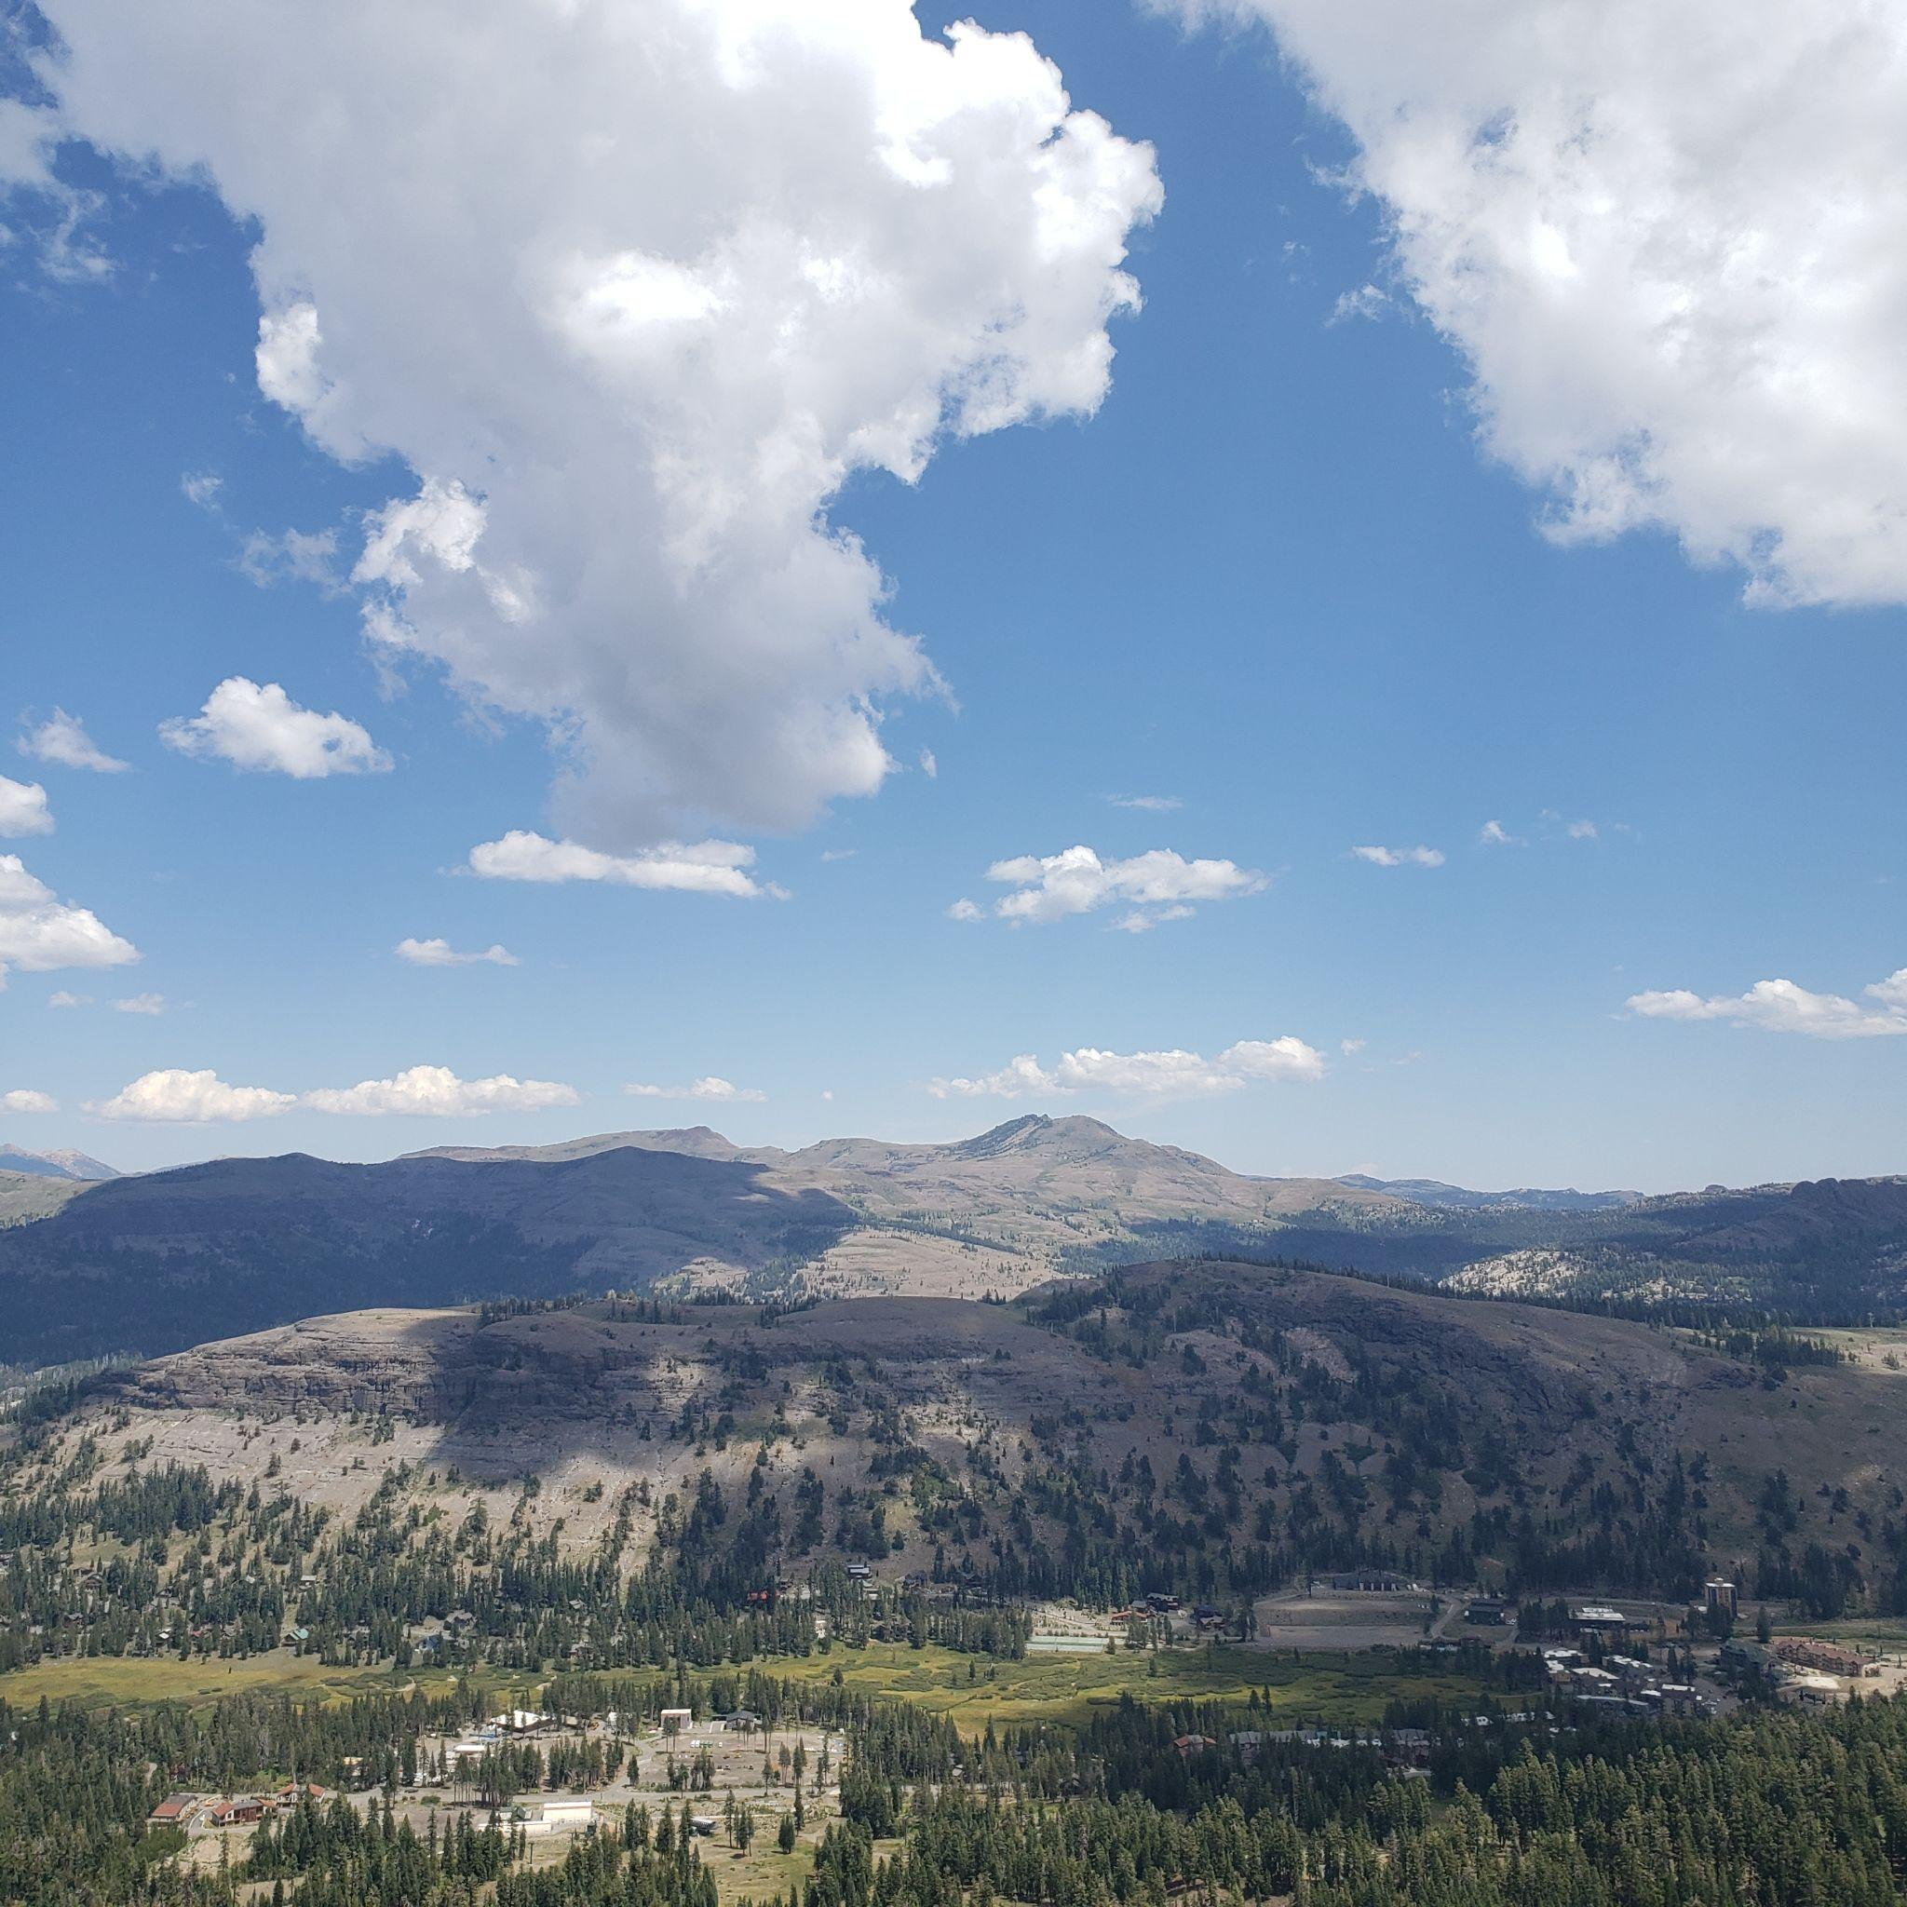
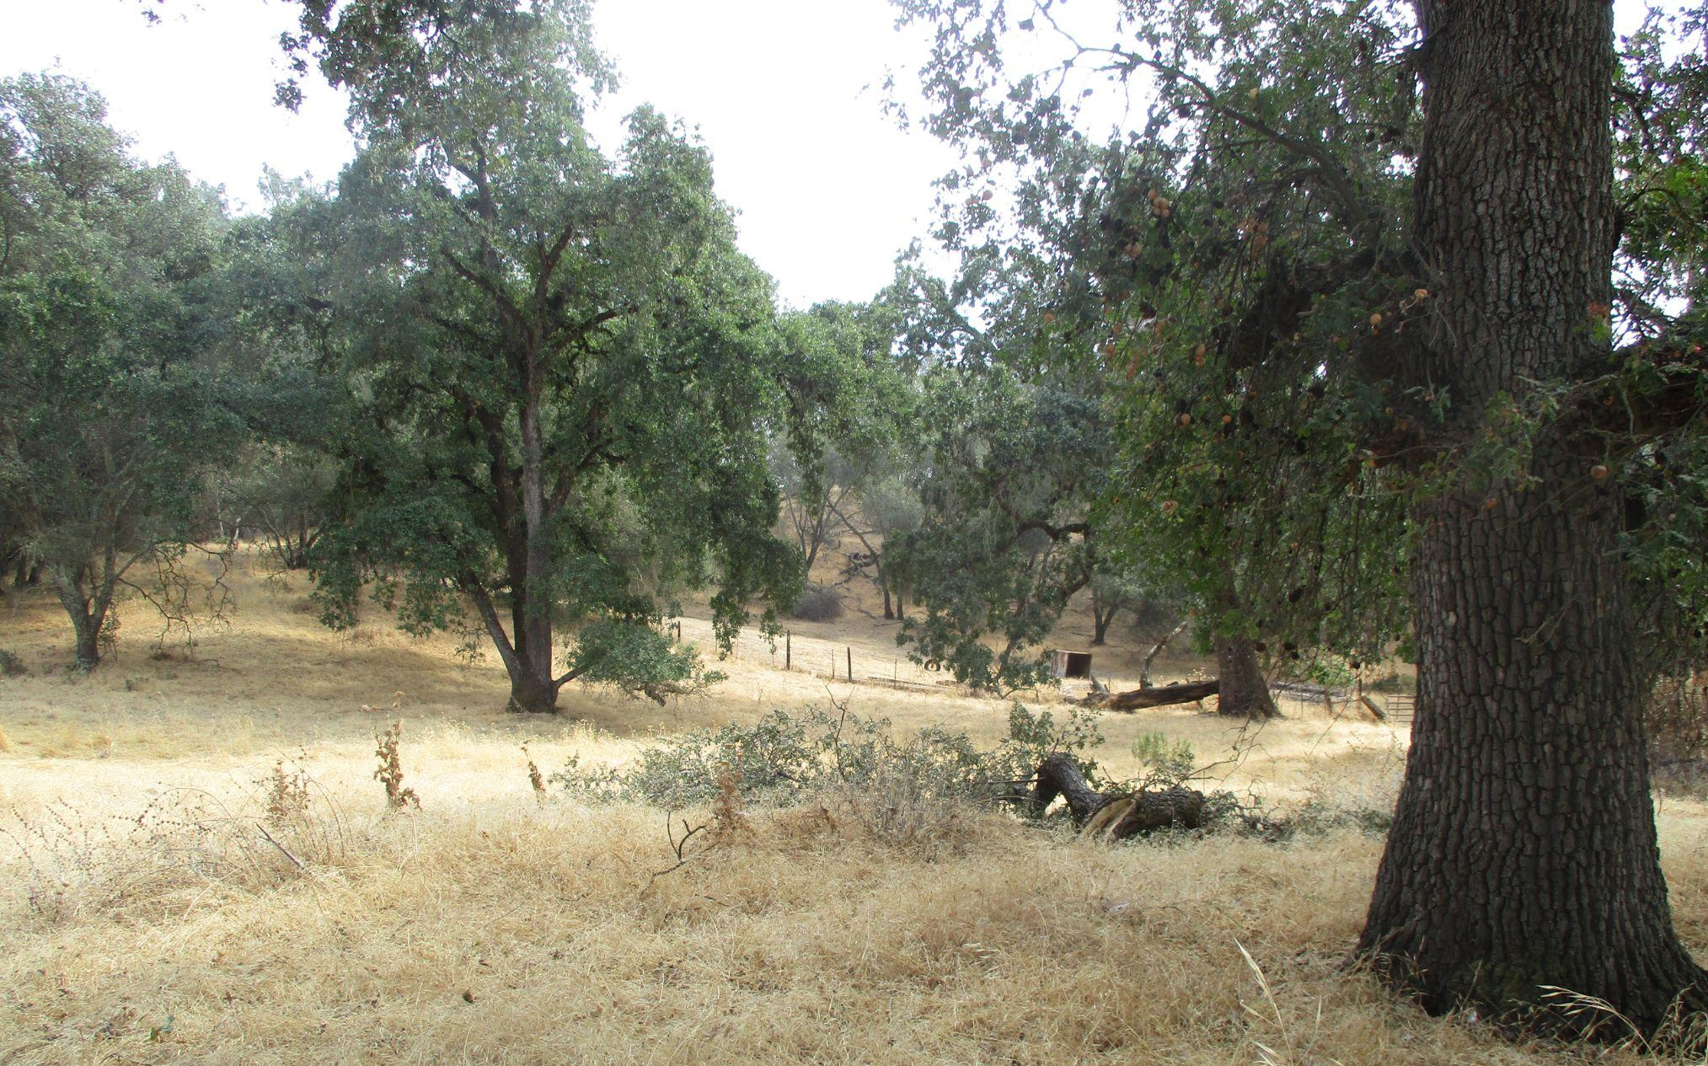
Open Space
Goals and Policies
Implementation Plan Measures
Scenic Corridors Recreation
Natural Resources and Species Protection
Program P-13: | Scenic Highway Corridor Ordinance
AMADOR COUNTY
PLANNING
‹#›

Slide 12
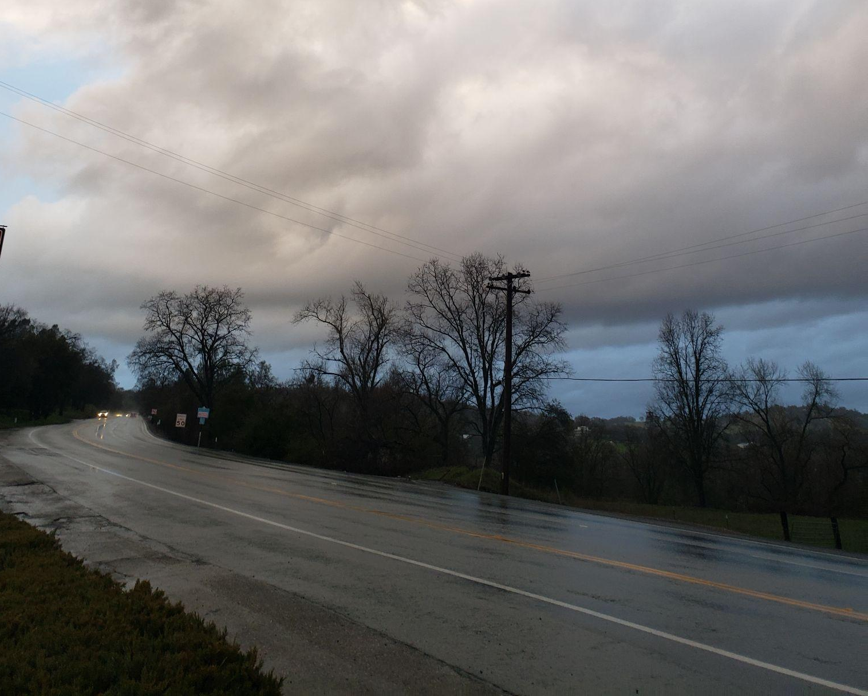
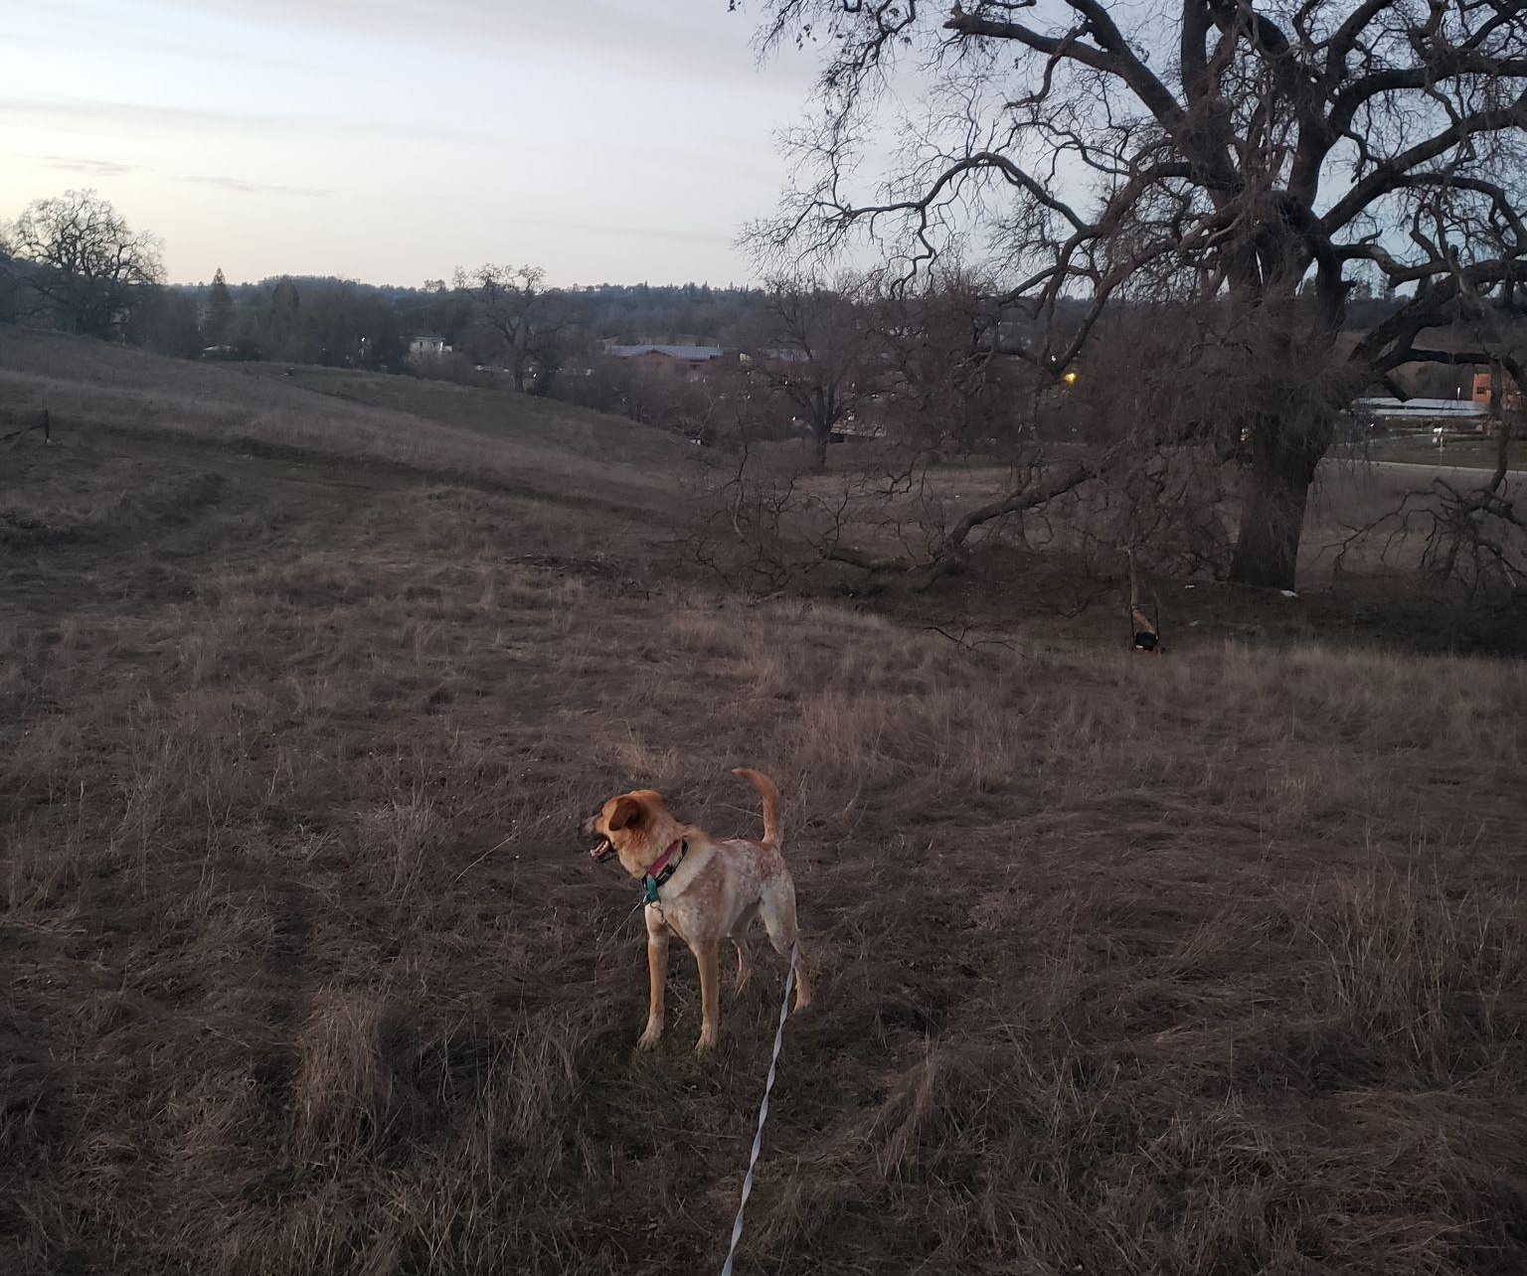
Noise
Implementation Plan Measures
Goals and Policies
Program D-11: | Noise Standards
Noise and Land Use Planning
Roadway and Railroad Noise
Aircraft Noise
Stationary Noise Generators
AMADOR COUNTY
PLANNING
‹#›

Slide 13
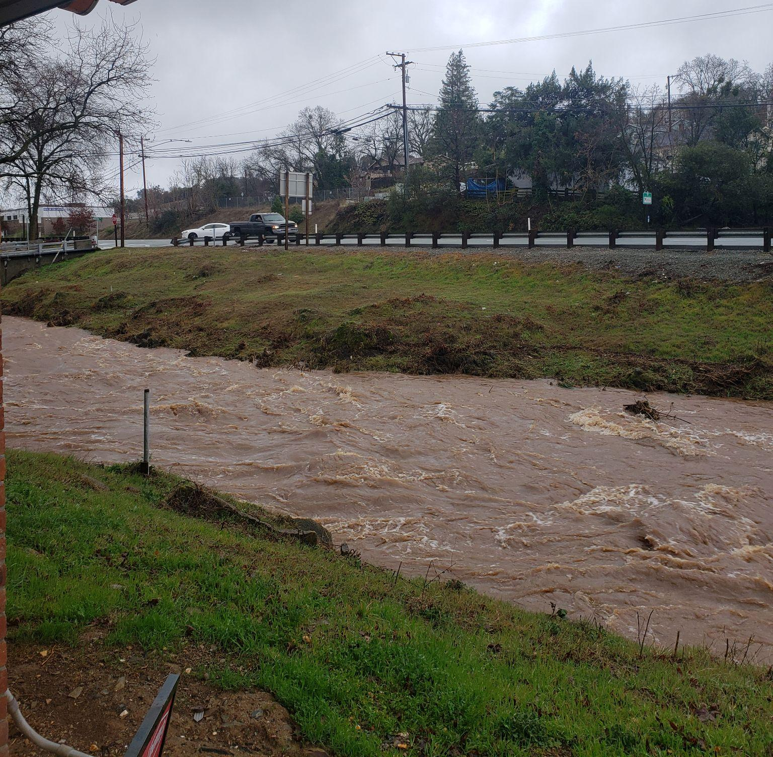
Safety
Goals and Policies
Flood Hazards
Fire Hazards and Protection
Geologic and Seismic Hazards
Mining and Hazardous Materials Sites
Public Safety and Emergency Preparedness
Implementation Plan Measures
Program D-2: | Fire- Safe Development
Program D-3: | Avoid Airport Hazards
Program D-7: Air | Emissions and Sensitive Receptors
Program D-8: | Soils and Geotechnical Evaluation
Program D-9: | Hazardous Materials
Program D-10: | Evacuation Planning and Routes
Program F-3: | Fire Services Funding
Program P-4: | Flood Planning
Program P-12: | Emergency Response
Program P-14: | Hazardous Materials Tracking
AMADOR COUNTY
PLANNING
‹#›

Slide 14
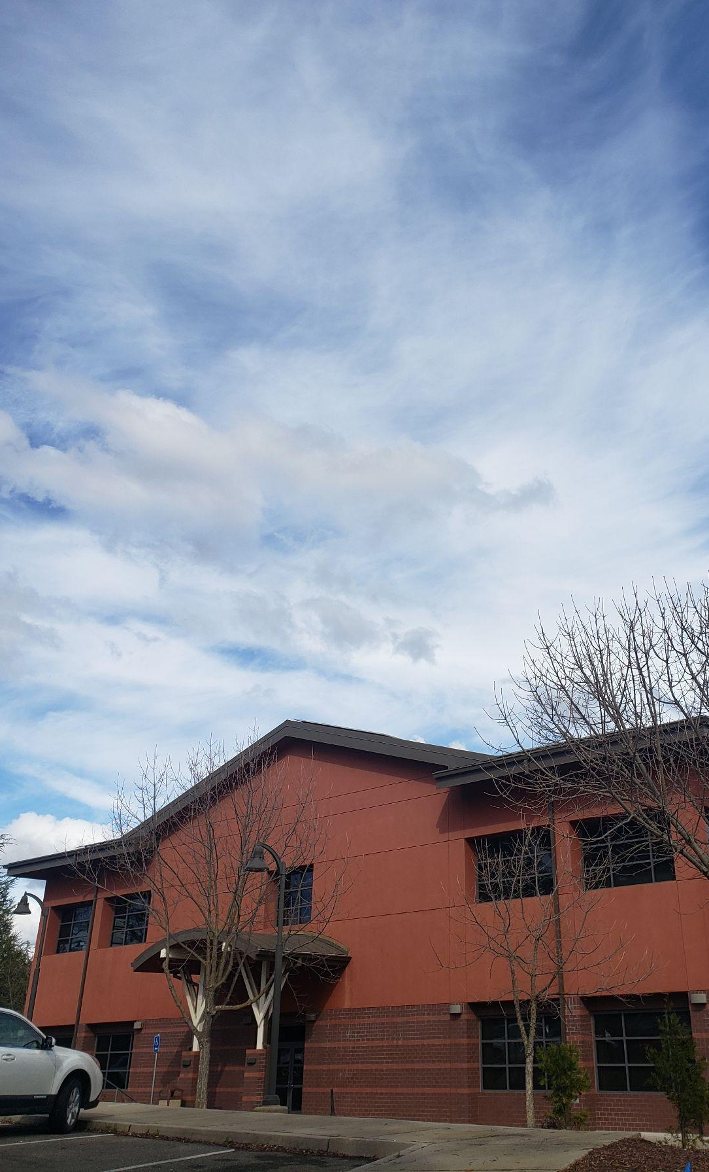
Governance
Implementation Plan Measures
Program P-6: | Effective County Services
Program P-7: | Effective Health Care and Community Services
Program P-8: | Early Care and Education
Program O-1: | Public Meetings
Program C-1: | Federal Notification
Program C-4: | Interagency Coordination
Program C-5: | Tribal Coordination
Program C-9: | Schools and School Funding
Goals and Policies
Public Involvement
Cooperation with Other Local Agencies
Cooperation with State, Federal, and Tribal Agencies
AMADOR COUNTY
PLANNING
‹#›

Slide 15
Economic Development
Goals and Policies
Implementation Plan Measures
Program P-2: | Economic Development Plan
Program P-9: | Mineral Resource Management
Program P-10: | Timber Production
Program P-11: | Farmland
Program C-2: | Economic Coordination
Program C-6: | Tourism and Education
Program O-2: | Agricultural Viability
Economic Development
Tourism
Economically Viable Agriculture
Timber Resources
Mineral Resources
Industrial Development
AMADOR COUNTY
PLANNING
‹#›

