Slide 1
Amador County General Plan
Accountability Measures and Monitoring Review 2018-2023
AMADOR COUNTY
PLANNING DEPARTMENT

Slide 2
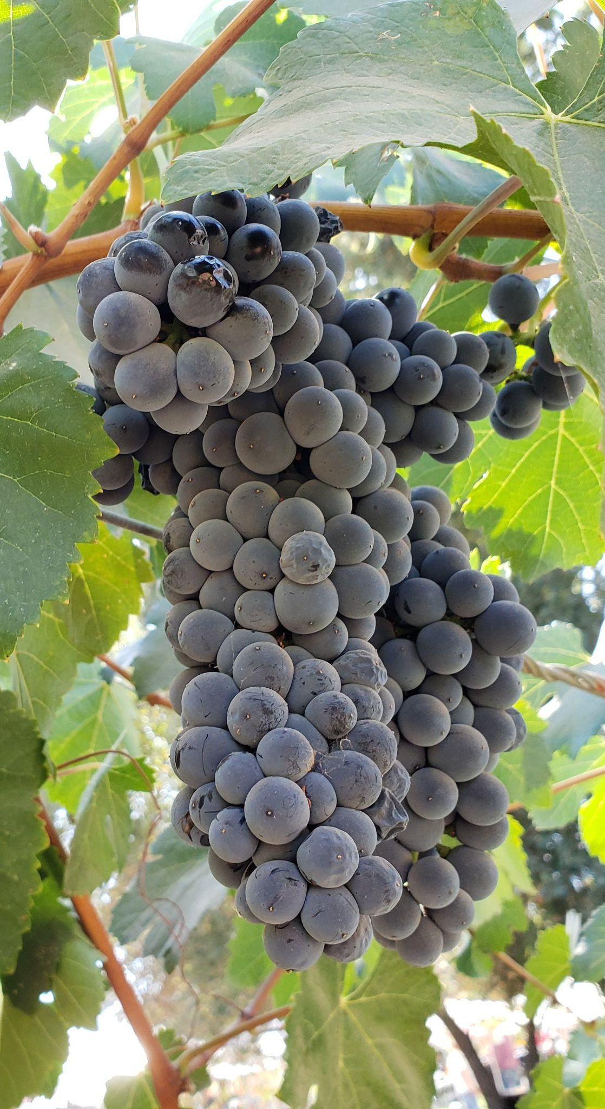
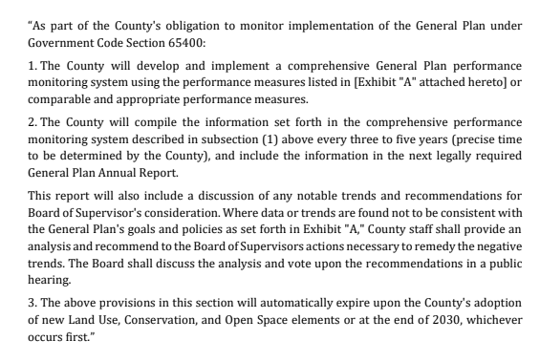
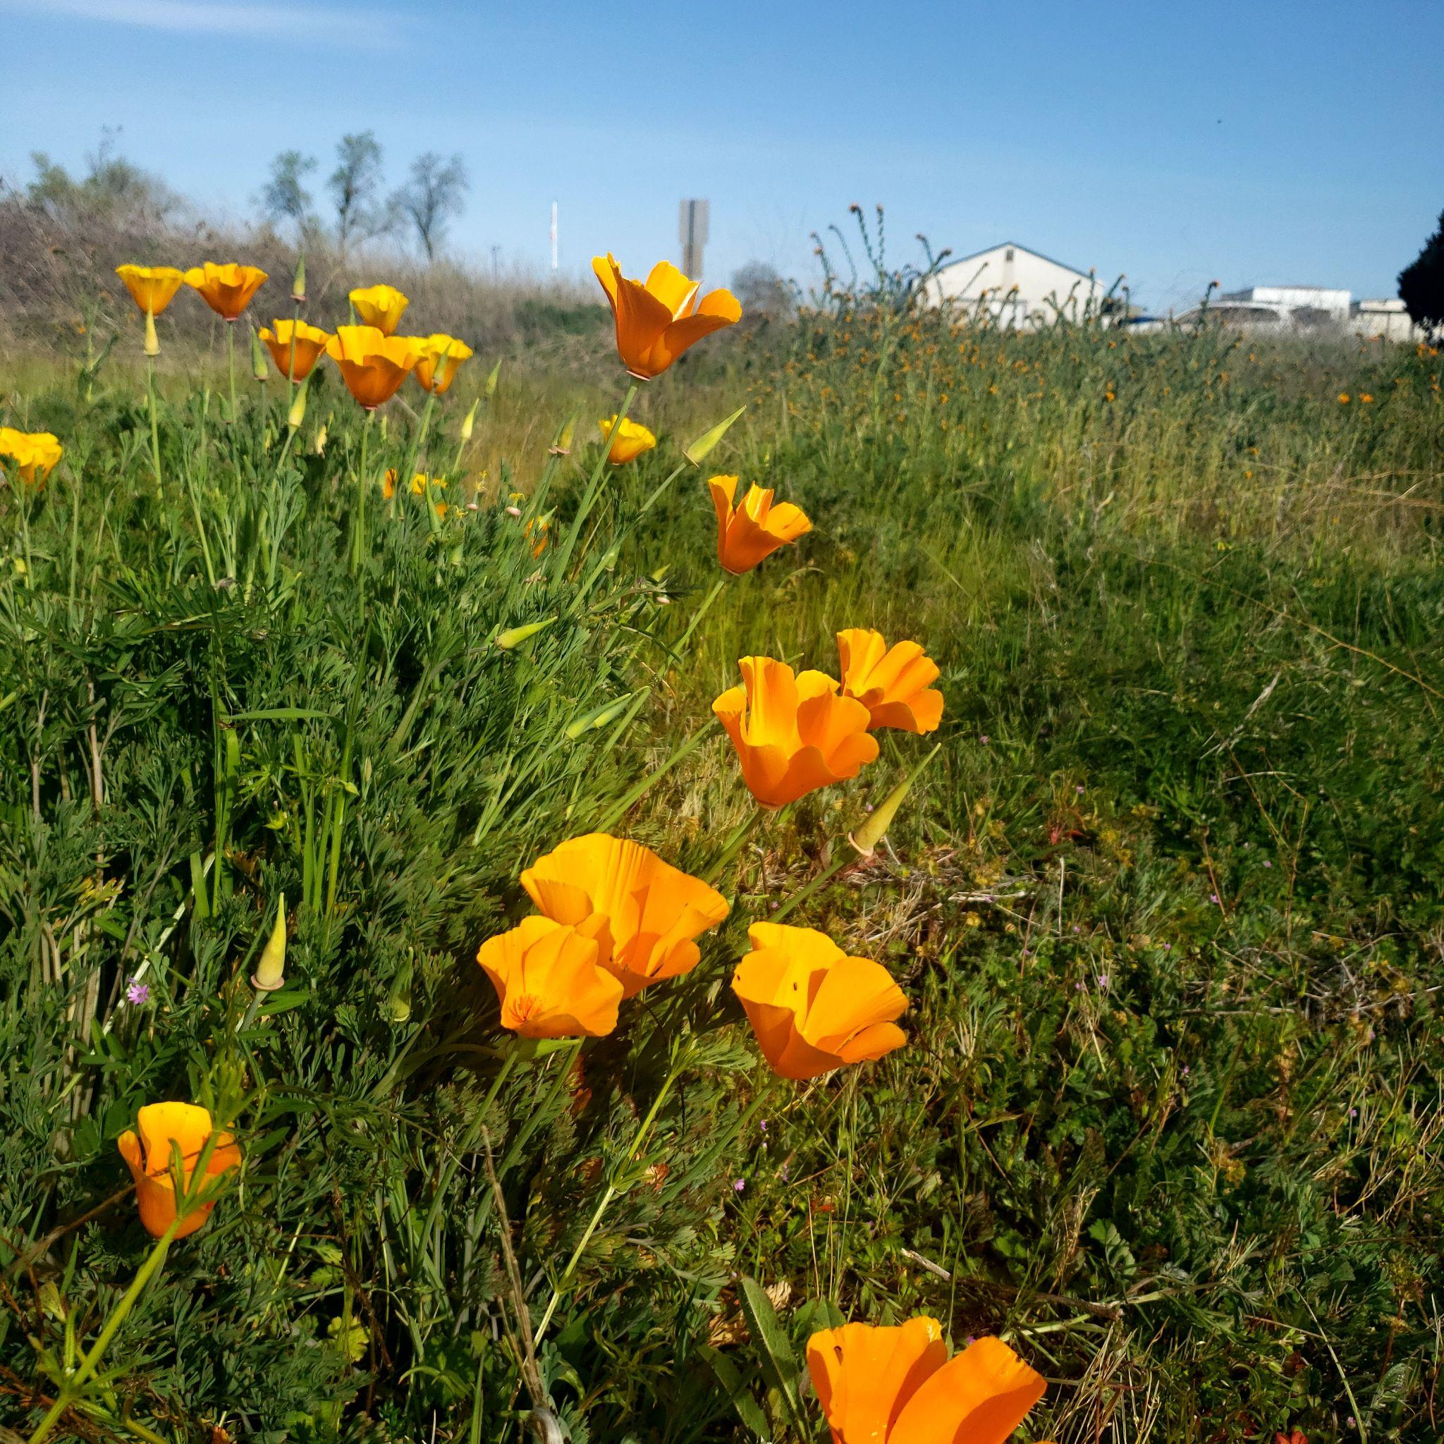
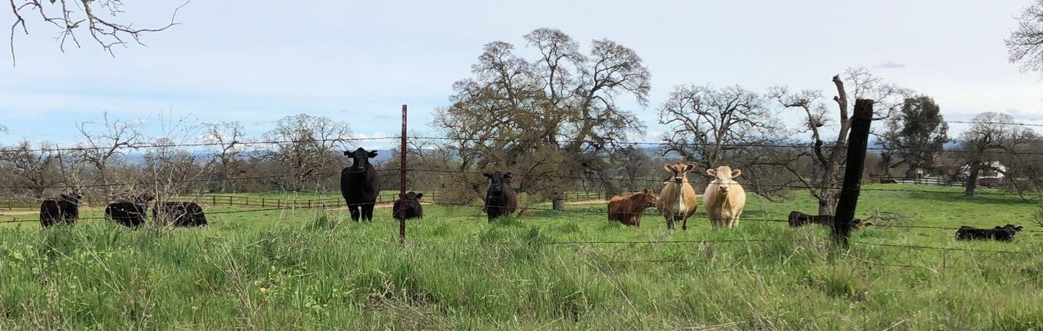
GOALS
AMADOR COUNTY
PLANNING
‹#›

Slide 3
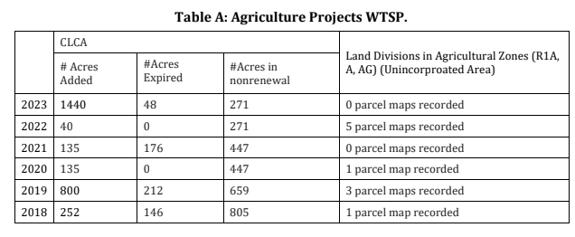
AGRICULTURE
Evaluation of Trends
Williamson Act
Timber Permits/Production
Agricultural Production
Variables:
Fires
Rainfall/Water
Economic Climate
Summary: There have not been significant negative trends related to agricultural or timber lands that could be considered inconsistent with General Plan goals and policies.
AMADOR COUNTY
PLANNING
‹#›

Slide 4
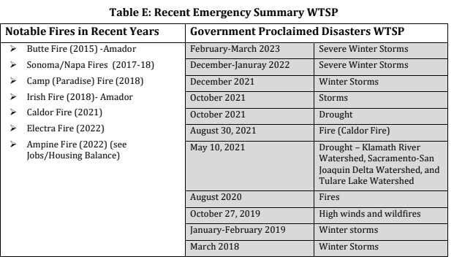
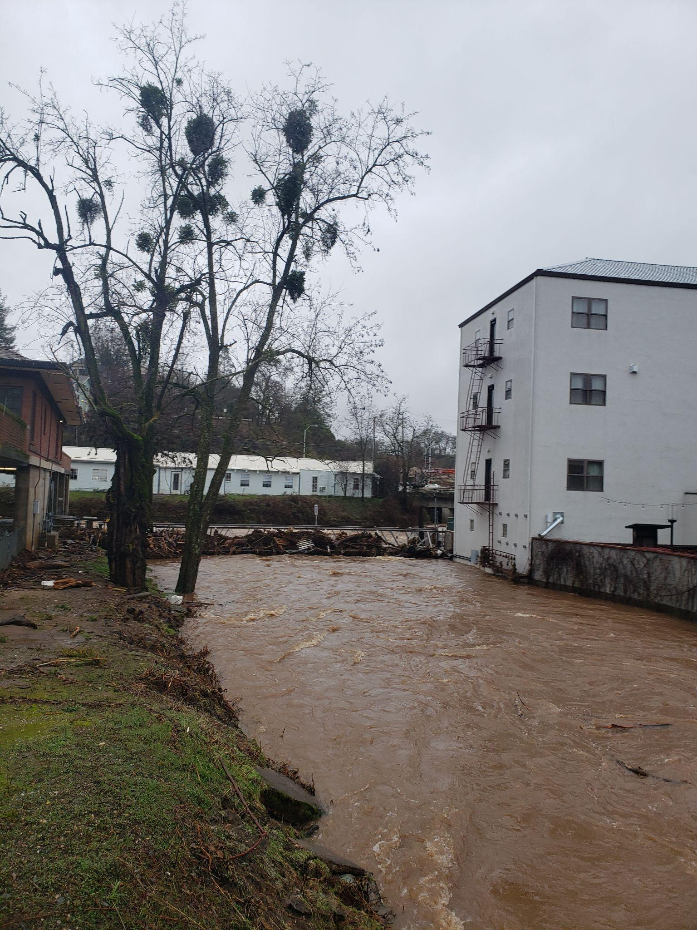
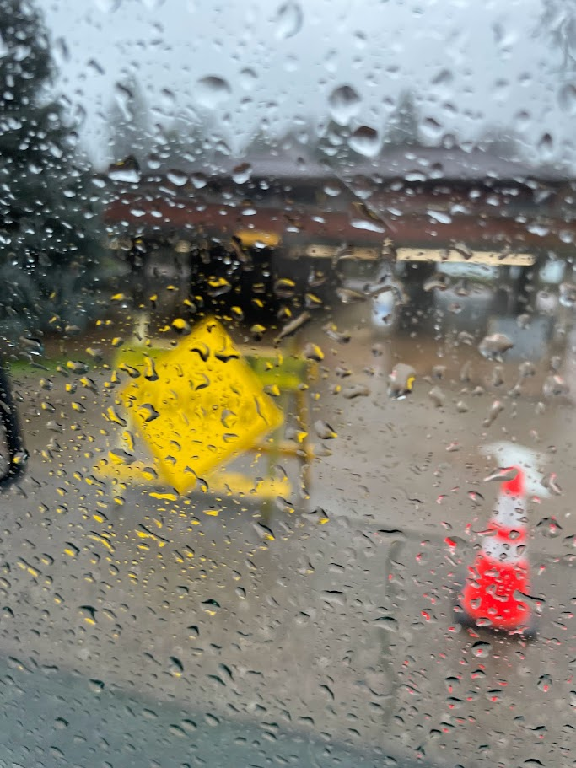
Wildland Fire and Public Safety
AMADOR COUNTY
PLANNING
‹#›

Slide 5
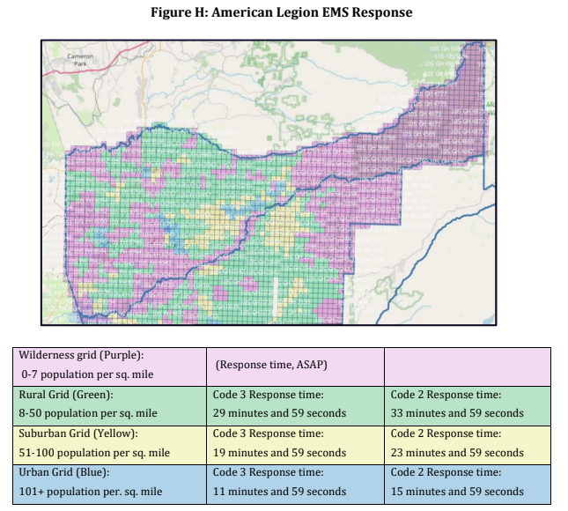
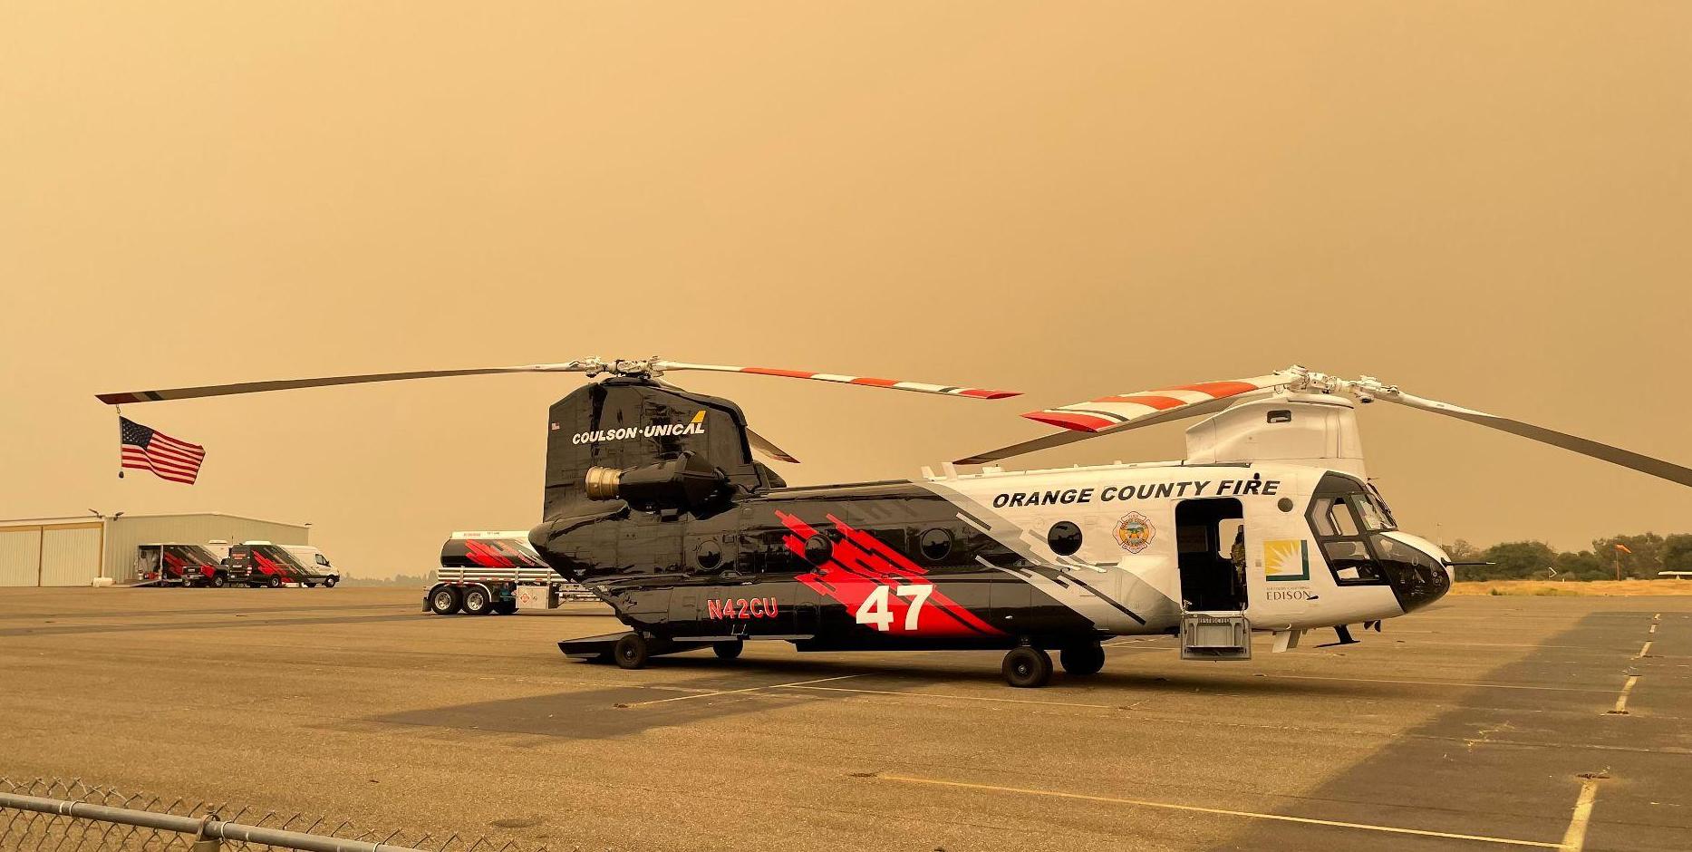
Wildland Fire and Public Safety
Variables:
Fires
Rainfall/Water
Disaster Events
Policy Change
Summary:There have not been significant negative trends related to wildland fire and public safety that could be considered inconsistent with General Plan goals and policies.
Evaluation of Trends
Emergency Response Times
Frequency of Emergency Events
Human-causation factors
AMADOR COUNTY
PLANNING
‹#›

Slide 6
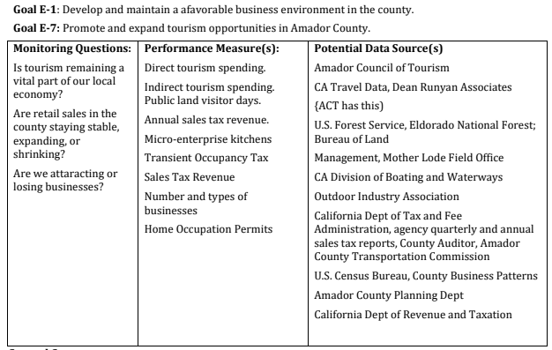
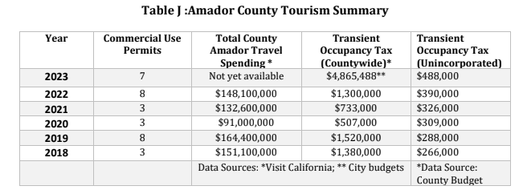
Economic and Business Health
Variables:
Distribution of Spending
Location of Development
Types of Businesses (Demand)
Evaluation of Trends
Tax income
Business Health
Tourism influx
Tourism Industries
Summary:There have not been significant negative trends related to economic and business health that could be considered inconsistent with General Plan goals and policies.
AMADOR COUNTY
PLANNING
‹#›

Slide 7
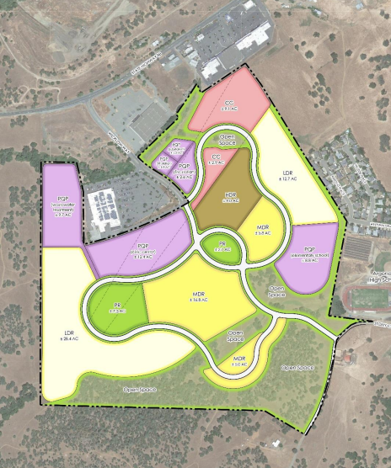
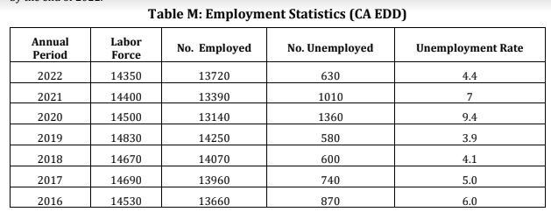
Jobs/Housing Balance
Variables:
Economic Fluctuation
Covid
Government Support for programs
Housing trends
Real estate market
Evaluation of Trends
Commuting Data
Employment Statistics
Housing Data
Summary: There have not been significant negative trends related to the jobs and housing balance that could be considered inconsistent with General Plan goals and policies.
AMADOR COUNTY
PLANNING
‹#›

Slide 8
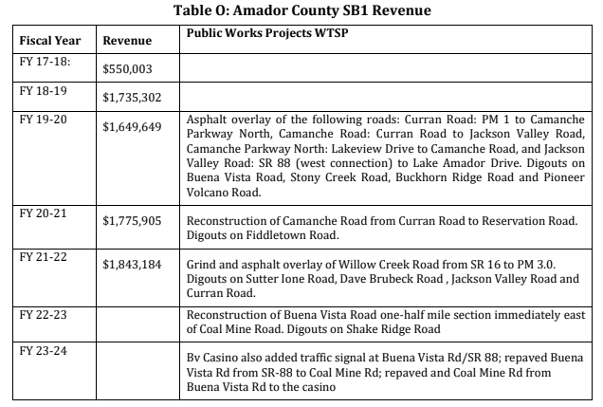
Roads
Evaluation of Trends
Road condition
Eminent Domain
Traffic Data
Variables:
Live/Work
New Development
Damage
Summary: The deterioration of County-maintained roads within the study period has been lessened in part due to slow growth in the unincorporated area, and the reduction in travel that resulted from the various stay-at-home restrictions implemented during the COVID-19 pandemic. While the condition of County maintained roads, as a whole, haven’t reached a critical threshold for motorist safety, the post-Covid increase in travel that accompanies the economic rebound will accelerate pavement deterioration and require the County to more aggressively pursue funding for maintenance and rehabilitation.
AMADOR COUNTY
PLANNING
‹#›

Slide 9
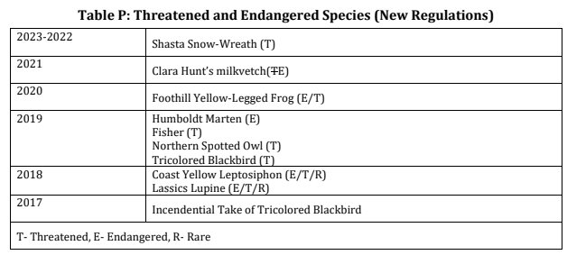
Biological Resources
Evaluation of Trends
Special Status Species
Conservation BMPs
Development Location/Region
Variables:
State Regulations
Climate/Weather
Migration
Habitat Loss Within Greater Ecoregion
Summary: There have not been significant negative trends related to biological resources that could be considered inconsistent with General Plan goals and policies.
AMADOR COUNTY
PLANNING
‹#›

Slide 10
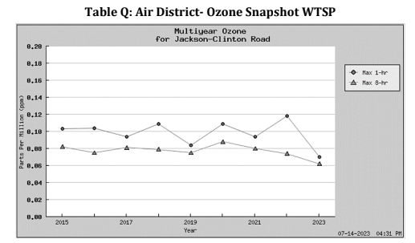
Air Quality
Evaluation of Trends
Overall Quality
Criteria Pollutants
Particulate Debris
Violations
Variables:
State Regulations
Fires/Burning
Summary: There have not been significant negative trends related to air quality that could be considered inconsistent with General Plan goals and policies.
AMADOR COUNTY
PLANNING
‹#›

Slide 11
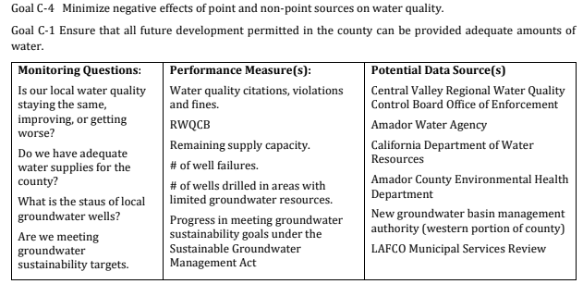
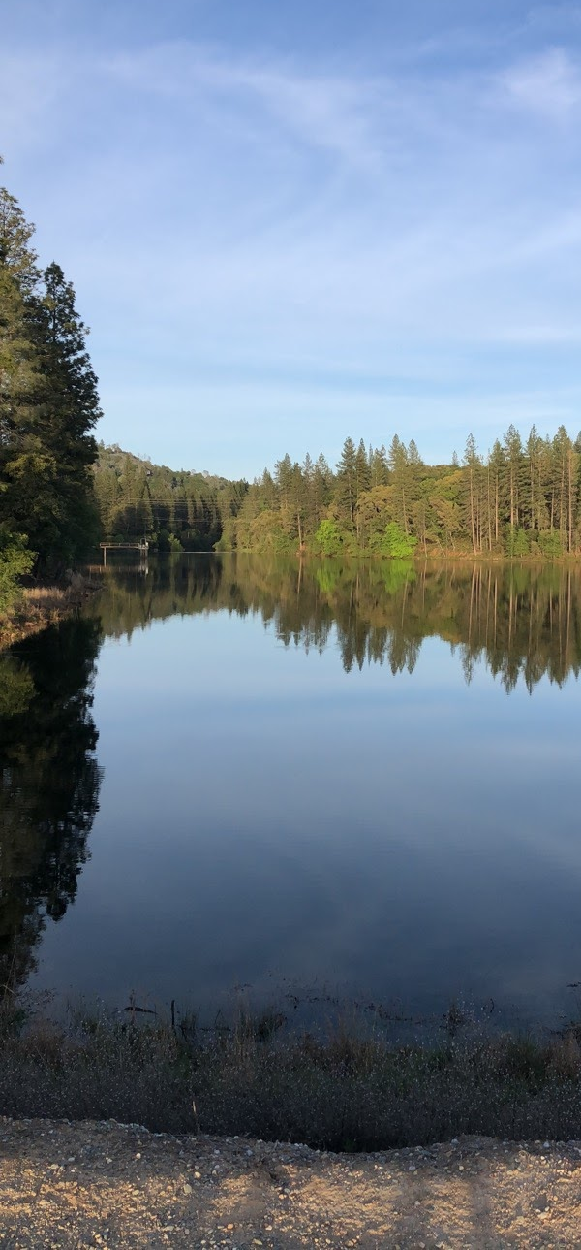
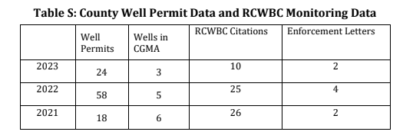
Water Quality
Evaluation of Trends
Overall Quality
Citations/Violations
Wells
Existing Water Systems
Variables:
New Developments
Construction
Large-scale Projects
Failures
Summary: There have not been significant negative trends related to water quality that could be considered inconsistent with General Plan goals and policies.
AMADOR COUNTY
PLANNING
‹#›

Slide 12
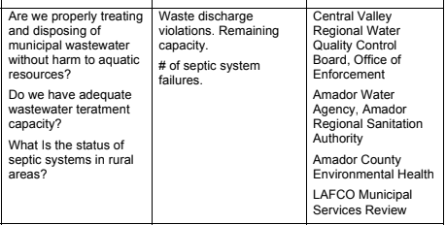
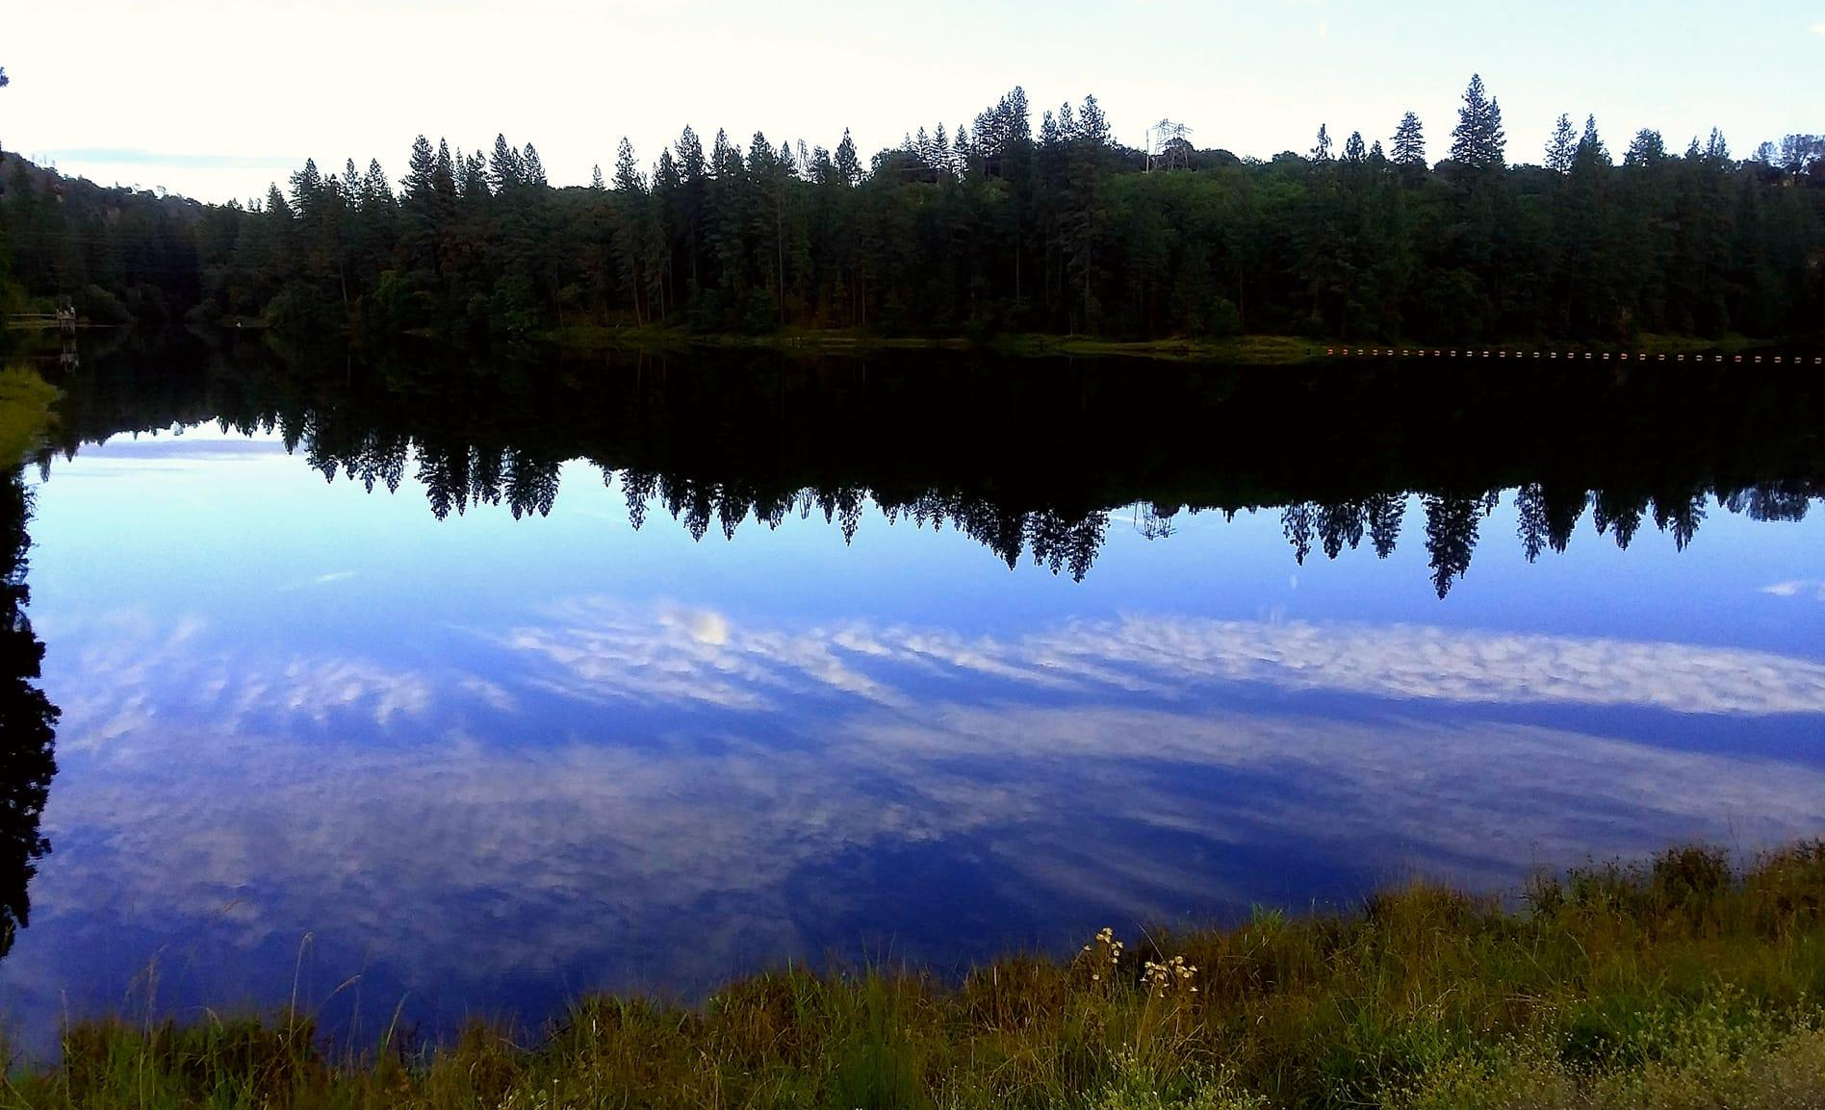
Wastewater Treatment
Monitoring Questions Performance Measures Potential Data Sources
Evaluation of Trends
Wastewater System
Moratoriums
Limitations on New Development
Citations/Violations
Variables:
New Developments and/or Build-out
System Stress
Changes in System Requirements
Summary: Overall, there have not been significant negative trends related to water quality that could be considered inconsistent with General Plan goals and policies.
AMADOR COUNTY
PLANNING
‹#›

Slide 13
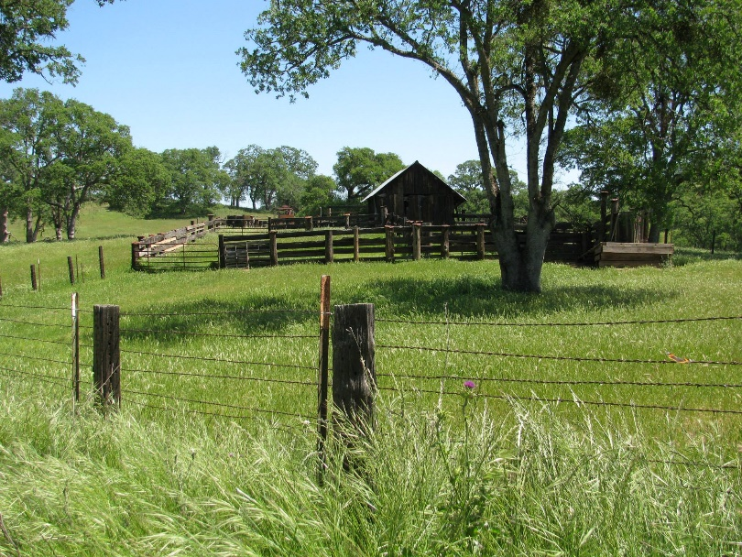
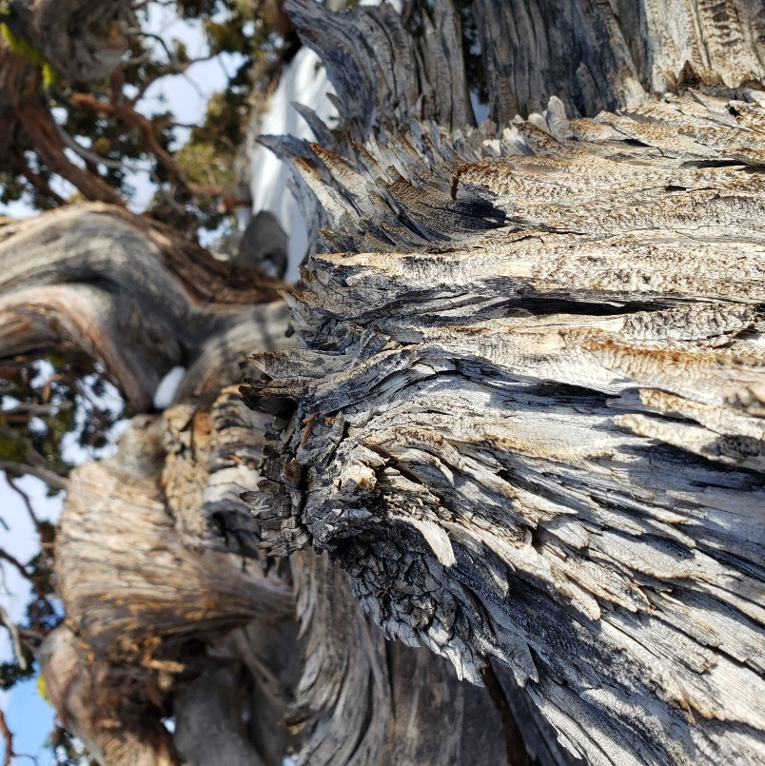
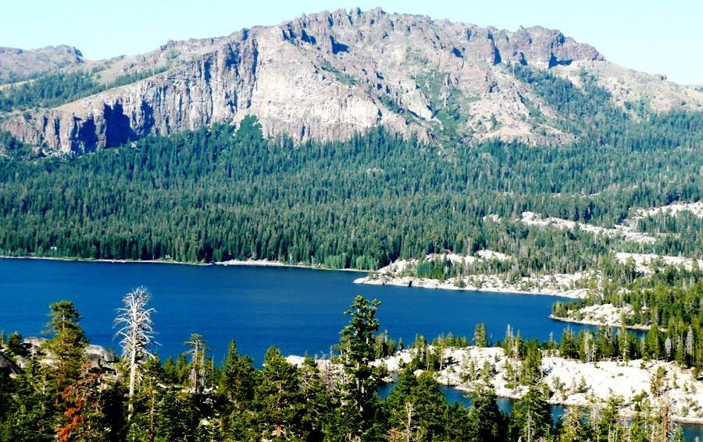
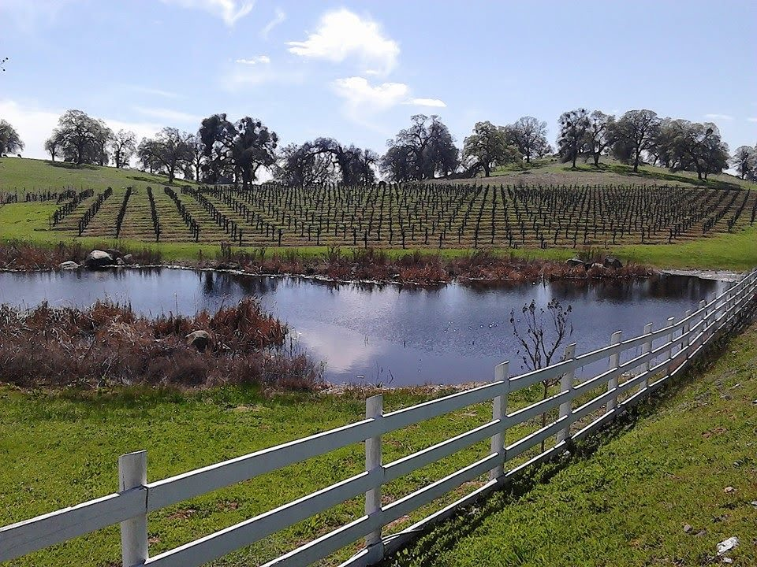
THANK YOU
Amador County Planning
(209)223-6380
planning@amadorgov.org
https://www.amadorgov.org/departments/planning
AMADOR COUNTY
PLANNING
‹#›

